Slide 1
HamSCI, solar eclipses and you.
William C. Liles NQ6Z
IEEE AP-S/URSI

Slide 2

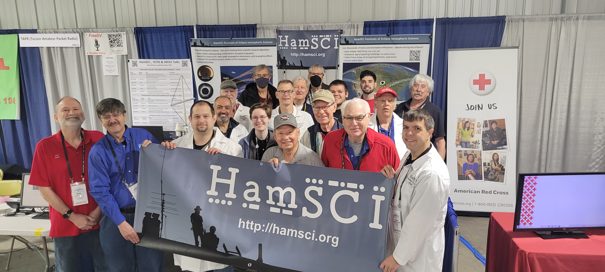
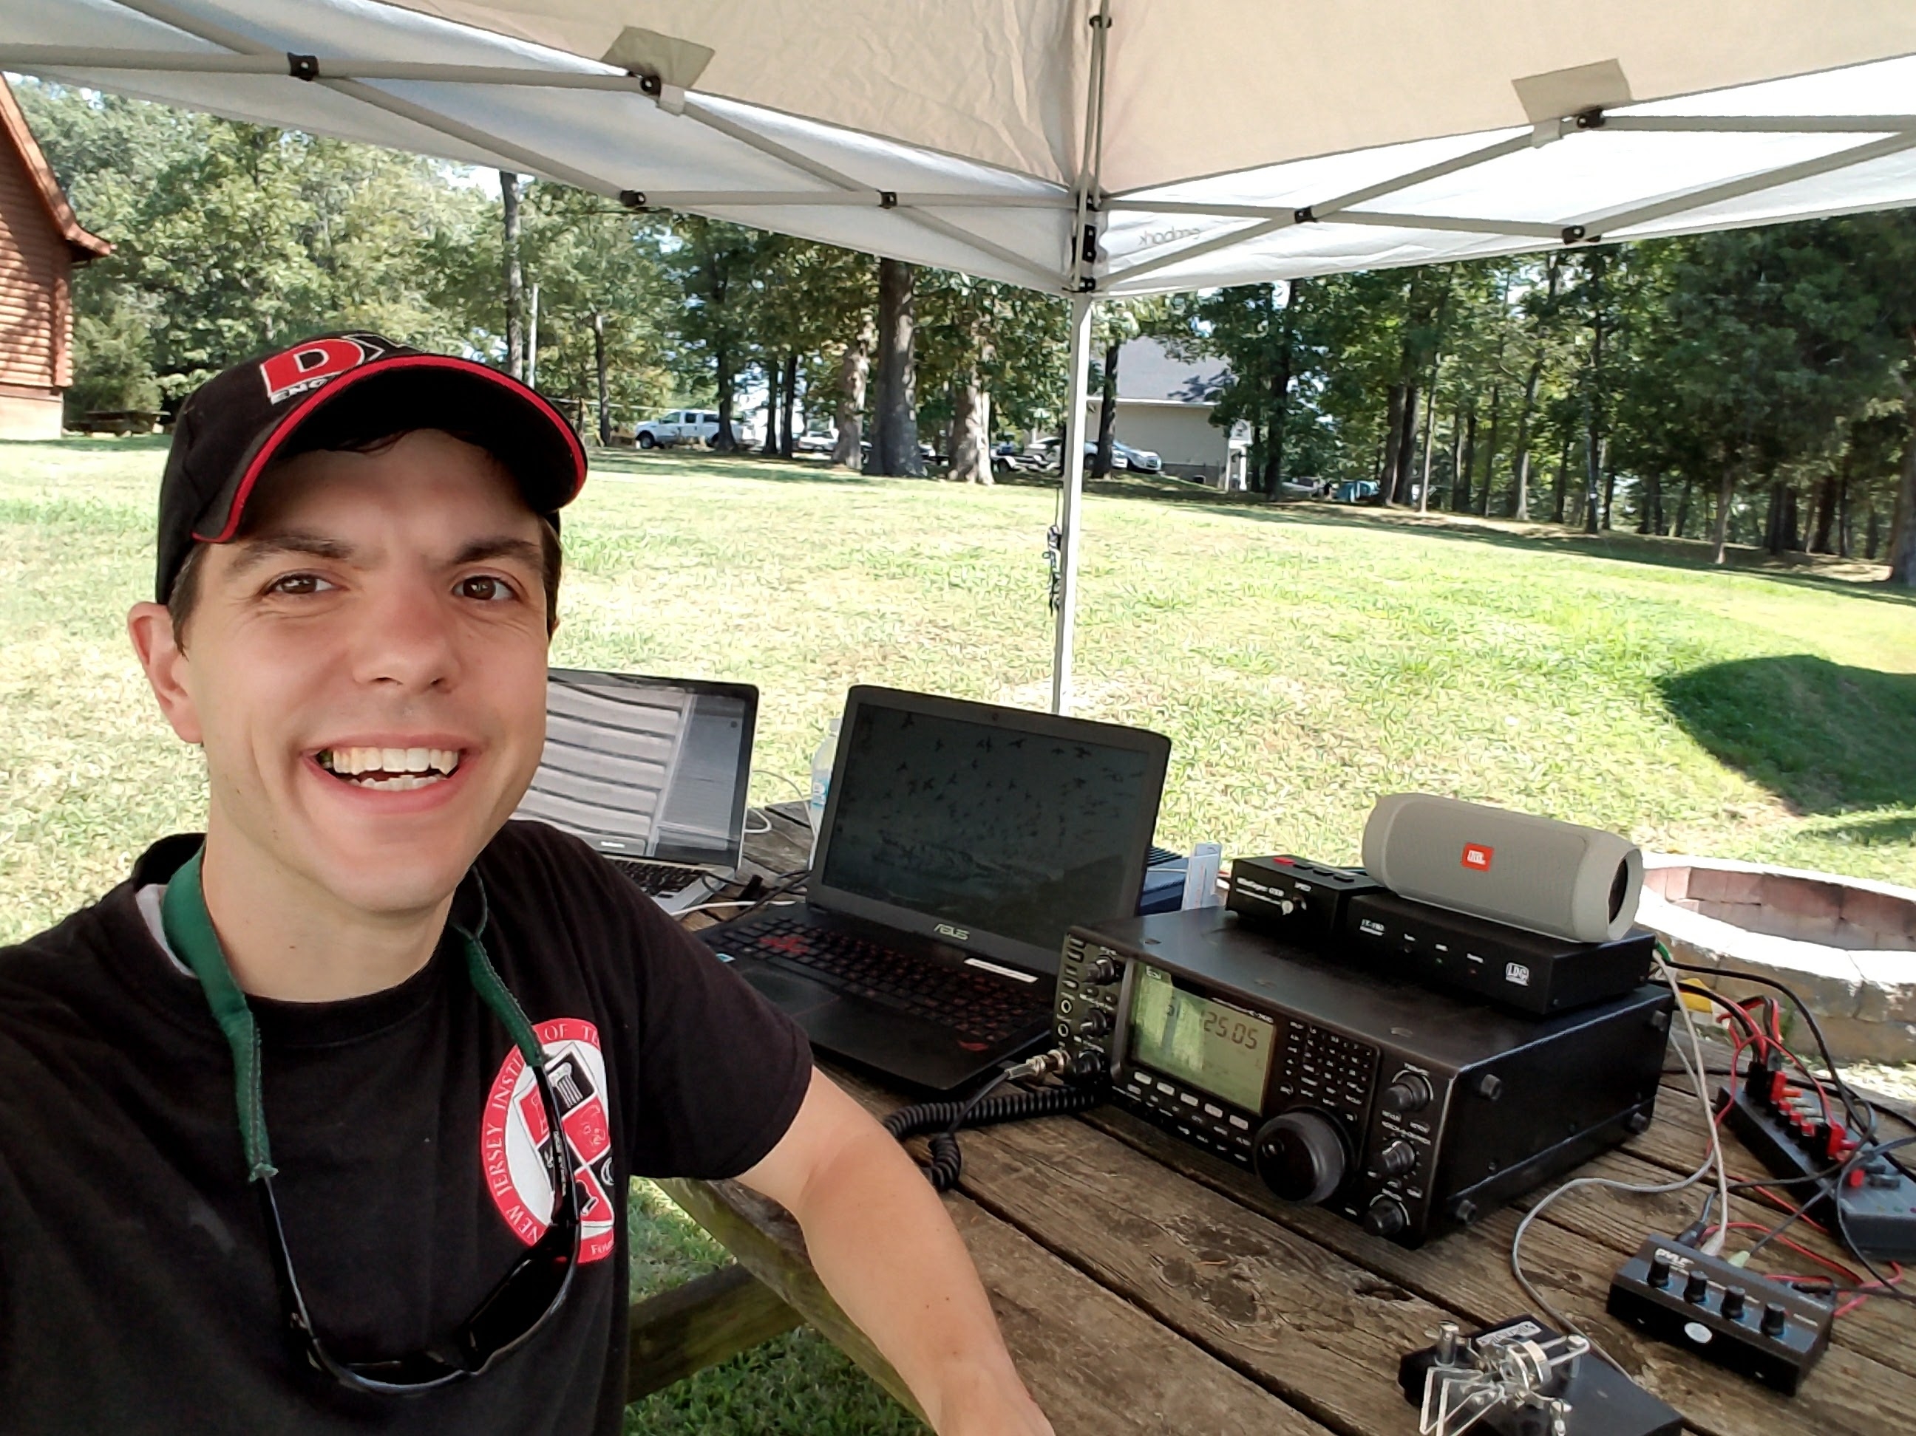

Ham radio Science Citizen Investigation
A collective that allows university researchers to collaborate with the amateur radio community in scientific investigations.
Objectives:
Advance scientific research and understanding through amateur radio activities.
Encourage the development of new technologies to support this research.
Provide educational opportunities for the amateur radio community and the general public.
Dayton Hamvention 2023
Founder/Lead HamSCI Organizer:
Dr. Nathaniel A. Frissell, W2NAF
The University of Scranton

Slide 3
Example HamSCI Projects
2023 & 2024 Solar Eclipse
Personal Space Weather Station
Grape Low-Cost Personal Space Weather Station (WWV Doppler Monitor)
TangerineSDR (High-performance Software Defined Radio)
Ground Magnetometer Module
VLF Receiver
Sources and Measurement of Traveling Ionospheric Disturbances
Convert PHaRLAP interface from MATLAB to Python
Experiential test transmissions from WWV and WWVH

Slide 4
Articles Accepted in Peer Reviewed Journals
American Geophysical Union
IEEE
Atmosphere
Frontiers in Astronomy and Space Sciences

Slide 5
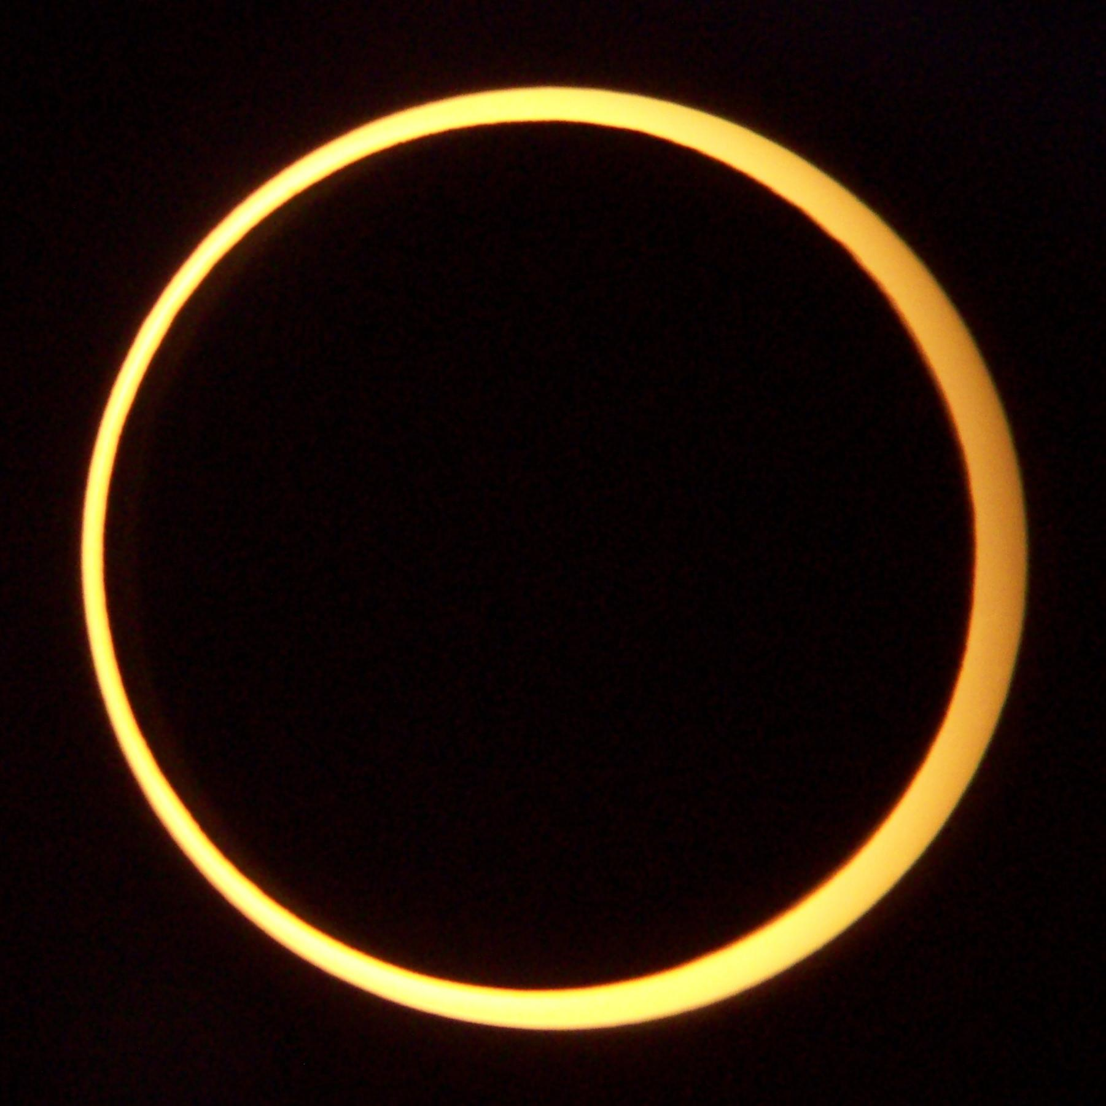
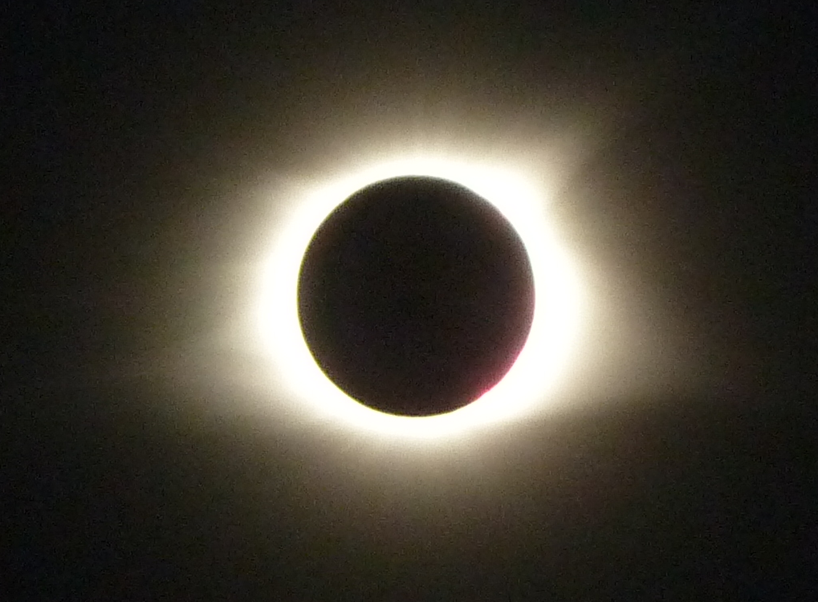
Upcoming Solar Eclipses
  Annular (2023)
Total (2024)
Photo By Smrgeog~commonswiki (https://commons.wikimedia.org/wiki/File:Annular_Eclipse._Taken_from_Middlegate,_Nevada_on_May_20,_2012.jpg)
Photo by Jim Sackerman, KC2ZFK

Slide 6
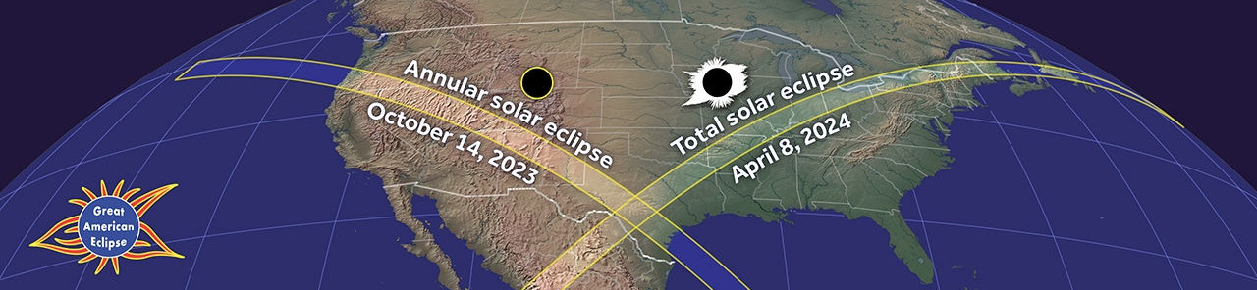
Solar Eclipses - 2023 and 2024
HamSCI is planning a full slate of events
Hams and shortwave enthusiasts are encouraged to join in!
HamSCI is promoting the Festivals of Eclipse Ionospheric Science

Slide 7
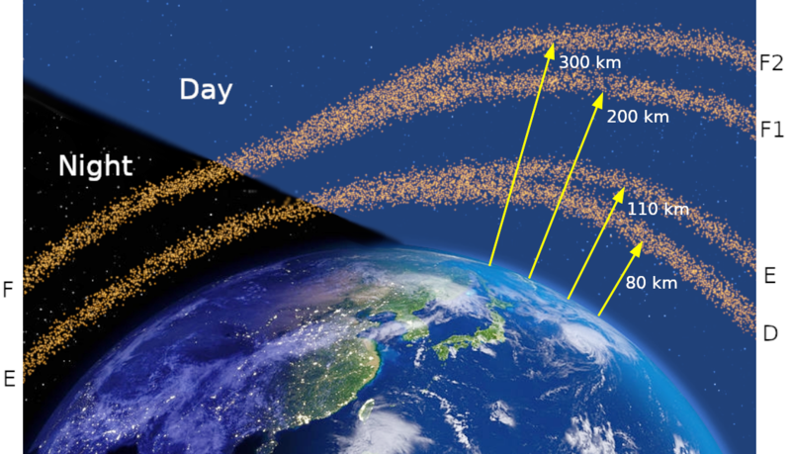
The Ionosphere
Figure by Carlos Molina (https://commons.wikimedia.org/wiki/File:Ionospheric_layers_from_night_to_day.png)

Slide 8
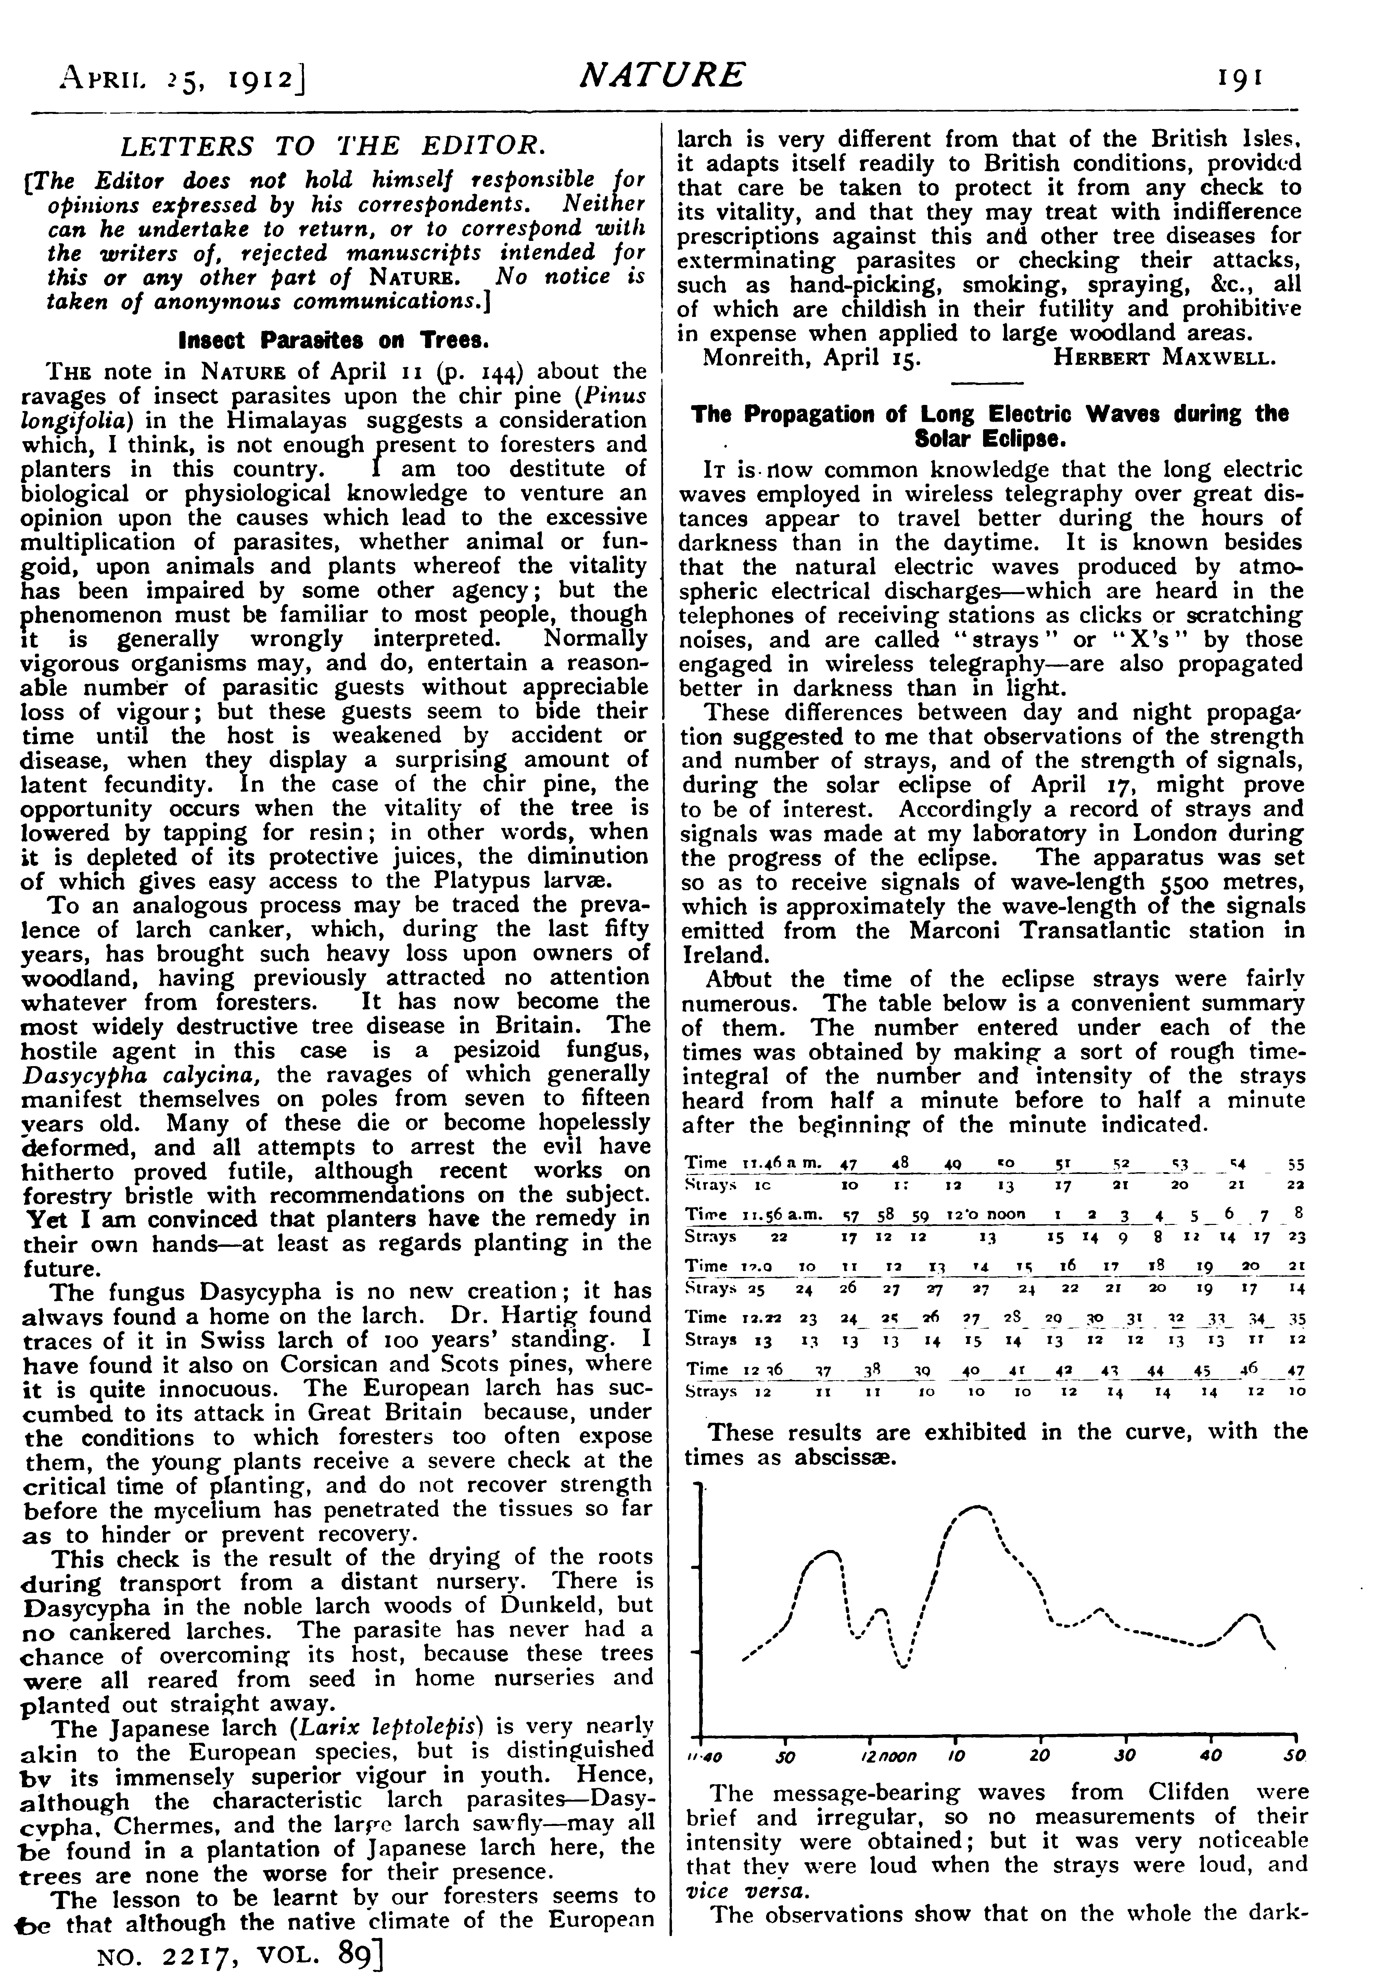
Historical Perspective
Spatial and temporal effects of solar eclipses on radio wave propagation continues to be of interest almost 100 years after the first reported study.
  During the Eclipse on April 17, 1912, William Henry Eccles¹ (1875 – 1968) a prominent British electrical engineer and scientist recorded discharges – clicks –strays.
  Wavelength 5,500 Meters (Frequency approximately (54.545 kHz)
  Published in Nature², 1912
The Marconi Transatlantic Station in Ireland transmitted to Lousibourg.
[1] Fellow of the Royal Society, President of the Physics Society, President of the Institute of Electrical Engineers and President of the Radio Society of Great Britain
[2] W. H. Eccles, “Propagation of Long Electric Waves during the Solar Eclipse” Nature, April 25th 1912
Rough time Integral of the intensity and duration of strays

Slide 9
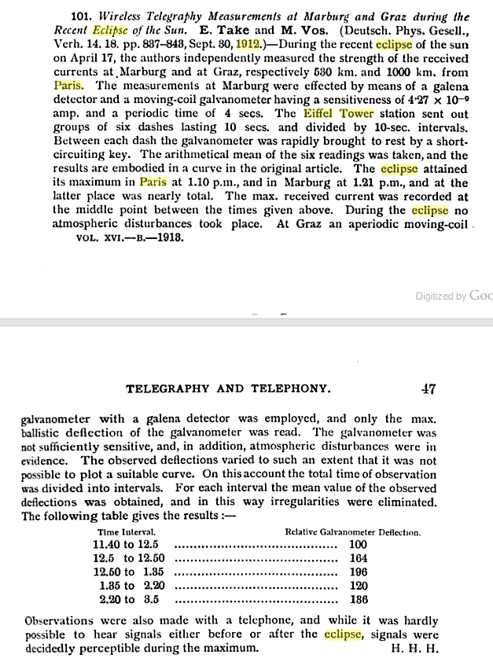
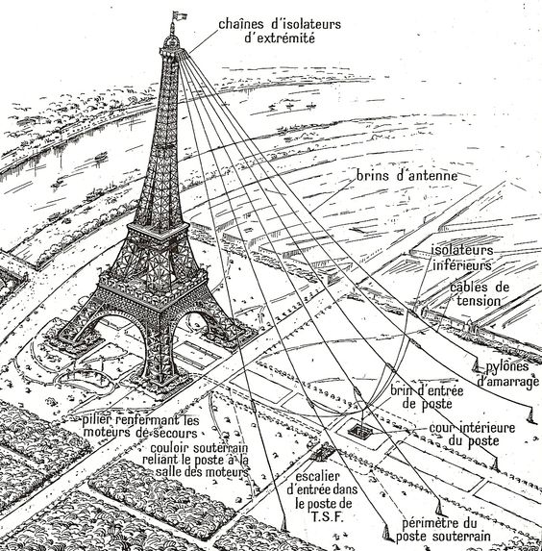
Other 1912 Solar Eclipse Studies
The 1912 solar eclipse was also collected in France and Denmark using the transmitter at the Eiffel Tower in Paris.
  The transmitter had a frequency of 115 kHz (wavelength approximately 2,608 meters)
  UK study was done at 54.545 kHz and French and Demark studies were done at 115 kHz, difficult for data comparison.
Galena and Galvanometer detector
[1] Images from de.wikipedia.org
[2] Telegraphy and Telephony, 1912

Slide 10
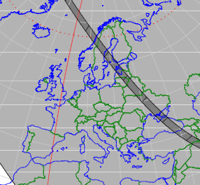
Early Attempt at Group Collection
First Group Effort on Eclipse Affecting Radio
  Planned for August 21, 1914
  WWI impacts data collection and analysis
  Group activity envisioned early on
[1] http://astro.ukho.gov.uk/eclipse/0311914/S1914Aug21.pdf

Slide 11
First Theory Paper
Hantaro Nagaoka, “Effects of Solar Eclipse on Wireless Transmission,” Mathematico-Physical Soc., Tokyo, Proceedings 7, pp 428-430 December 1914
Note: The word Ionosphere did not exist until created by Robert Watson Watt in 1926

Slide 12
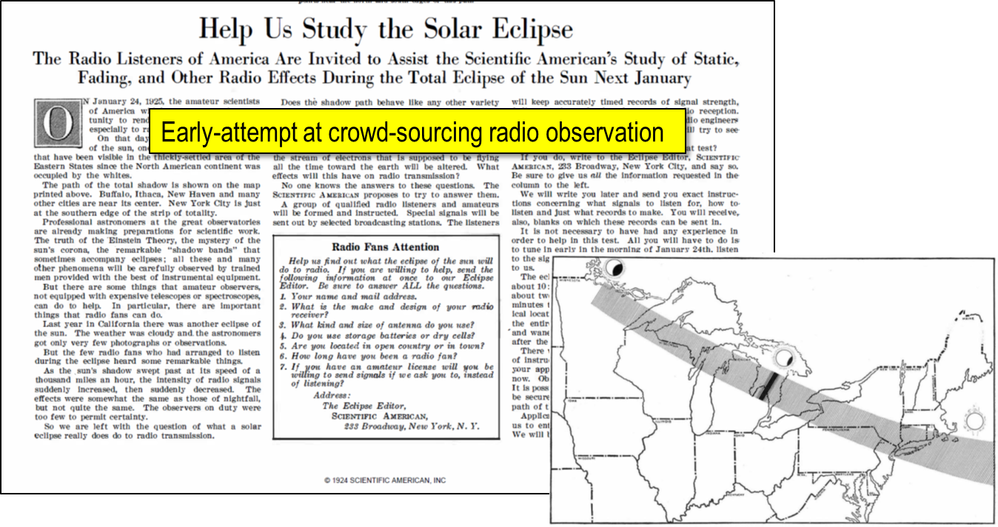
Early Crowdsourcing Effort
January 25, 1925 Solar Eclipse
  Teamed with Scientific American
  Noticed 75 meter daytime signals arrived with intensity associated with nighttime signals - Many errors in reporting¹
  Over 2,000 BCB reporters and co-operation from BCB transmitters
[1] Reports in Scientific American and QST

Slide 13
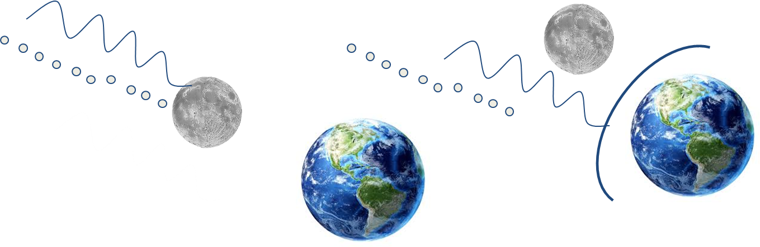
Ionosphere Ionization Experiment
In the 1920s, it was understood that the sun caused the ionization of the ionosphere. Two possible mechanisms were hypothesized:
    1) electromagnetic waves emitted by the sun
    2) particles emitted by the sun
Sir Edward Appleton (Nobel Prize in Physics in 1947 for ionosphere studies) proposed an experiment where the moon during a solar eclipse would stop both the electromagnetic waves and the particles.
Electromagnetic waves travel at the speed of light (3,000,000 km/sec)
Particles travel much slower (approx. 1,000 to 2,000 km/sec)
If the ionosphere becomes re-ionized quickly after the eclipse, then due to electromagnetic waves.

Slide 14
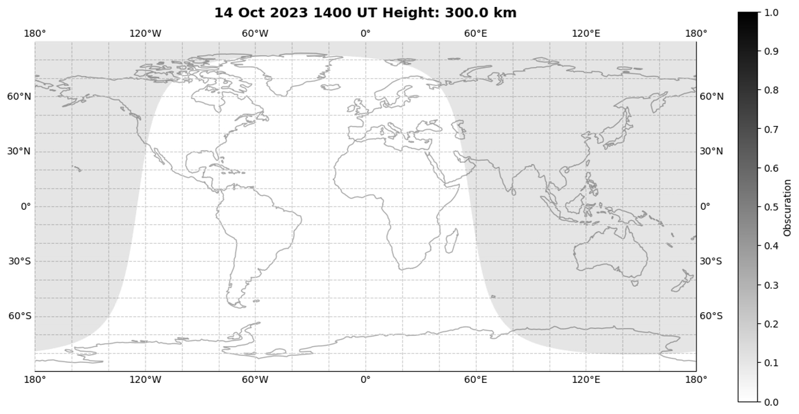
Annular Solar Eclipse: October 14, 2023
Plot generated by Dr. Nathaniel A. Frissell, W2NAF

Slide 15
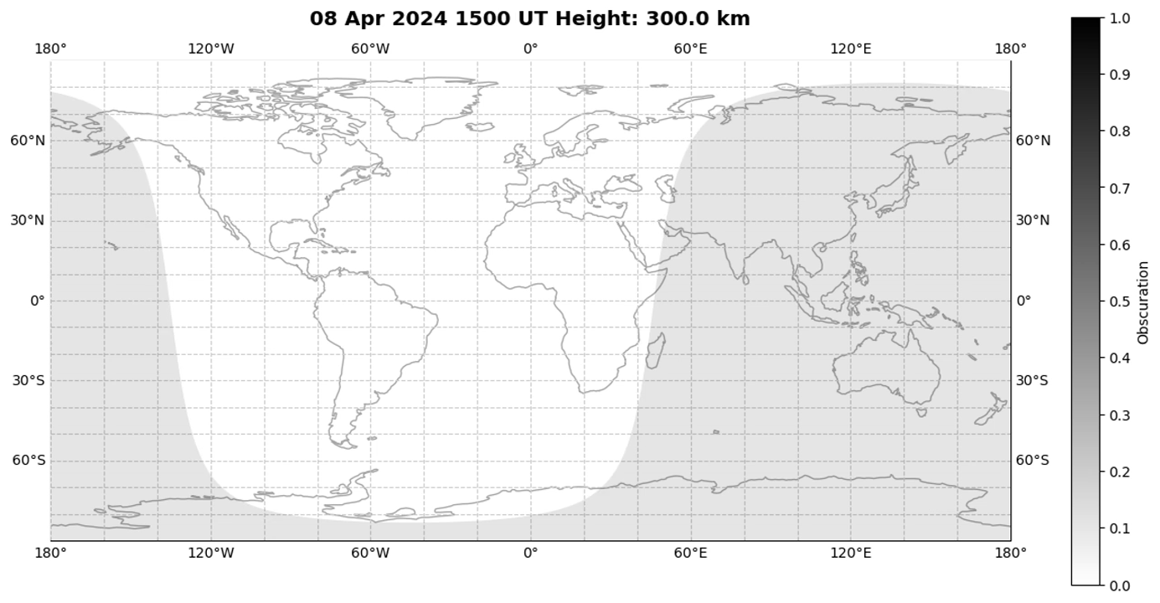
Total Solar Eclipse: April 8, 2024
Plot generated by Dr. Nathaniel A. Frissell, W2NAF

Slide 16

Ham Radio Competitions: The Solar Eclipse QSO Party and Gladstone Signal Spotting Challenge
Participate in a controlled experiment on the 160, 75 or 40 meter bands: Time Delay of Arrival Event
Build and install a Grape Personal Space Weather Station (PSWS)
www.hamsci.org/eclipse

Slide 17
QSO Party: The More the Merrier
Hundreds of hams operating simultaneously - resulting in thousands of QSOs and spots per hour
Ham radio’s version of a cocktail party - in a really, really big room (potentially the entire Earth)
HamSCI organized the 2017 Solar Eclipse QSO Party (SEQP) around the total eclipse which transited the North American continent
The 2017 SEQP was unique among ham events in that it had a scientific purpose: Data generation and collection for the purpose of ionospheric science
Log and spot data contributed directly to scientific research on the ionosphere. (Research results can be found at hamsci.org, search on ‘2017 eclipse’.)

Slide 18
2017 Solar Eclipse QSO Party Results
Participant’s Log Data
Submitted Logs | 566
Log QSOs | 29,809
Log Unique Calls | 4,929
Log 4-Character Grid Squares | 649
Log DX Entities | 80
Spotting Network Data
RBN Spots | 618,623
WSPRNet Spots | 630,132
PSK Reporter Spots | 1,287,962
A ‘spot’ signifies automated reception and entry into a database of a single station’s transmission
Each participant is encouraged to maintain a computer log of all QSOs - and to submit their log to HamSCI after the event

Slide 19
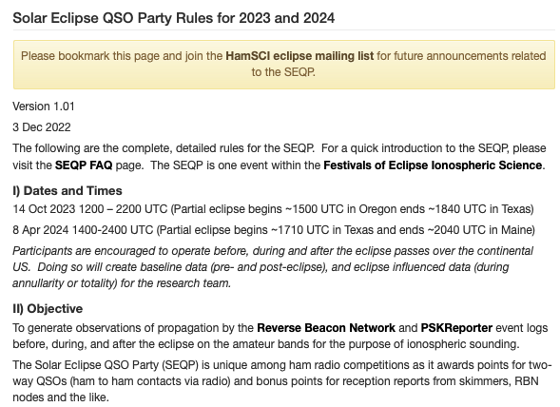
Solar Eclipse QSO Party 2.0
Taking the best concepts from the 2017 event yielded a fresh set of rules, FAQs, etc.
6-160 meters (non-WARC bands) using CW, SSB and digital modes
The HamSCI website is the ultimate resource:
https://hamsci.org/contest-info
https://hamsci.org/seqp-faqs
https://hamsci.org/seqp-rules
Results will be published

Slide 20
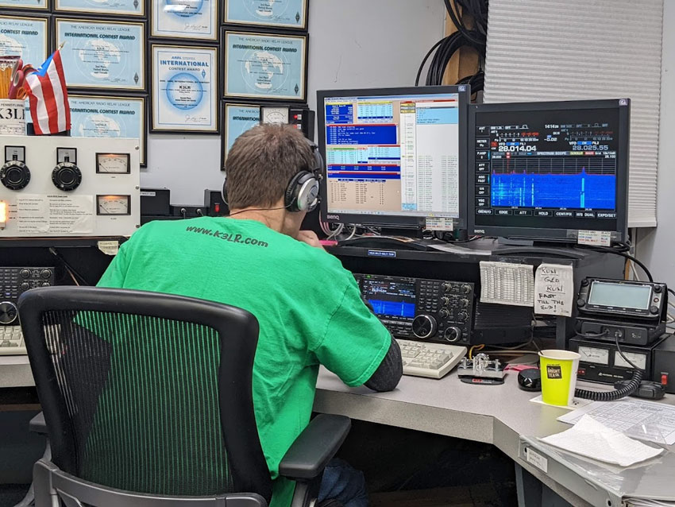
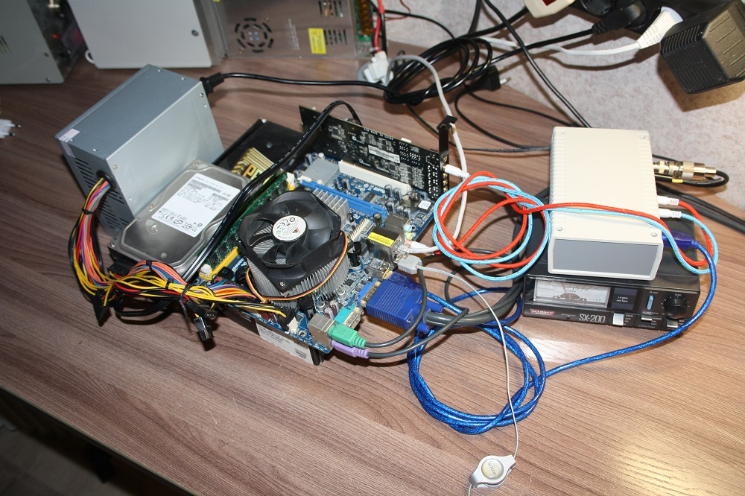
Appealing to a Broad Range of Interests
Typical QSO Party Participant
Homebrew WSPR Station
George N3GJ, operating at K3LR, courtesy of k3lr.com
Courtesy of wsprnet.org

Slide 21
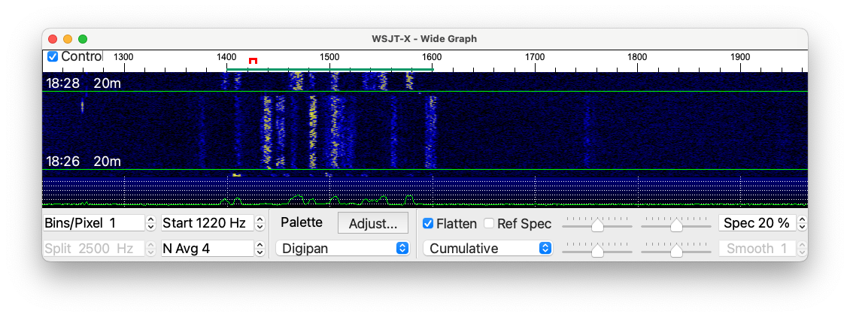
Gladstone Signal Spotting Challenge
Should appeal to those already interested in radio wave propagation
Employs digital modes used for both short term feedback and long term studies of HF propagation

Slide 22
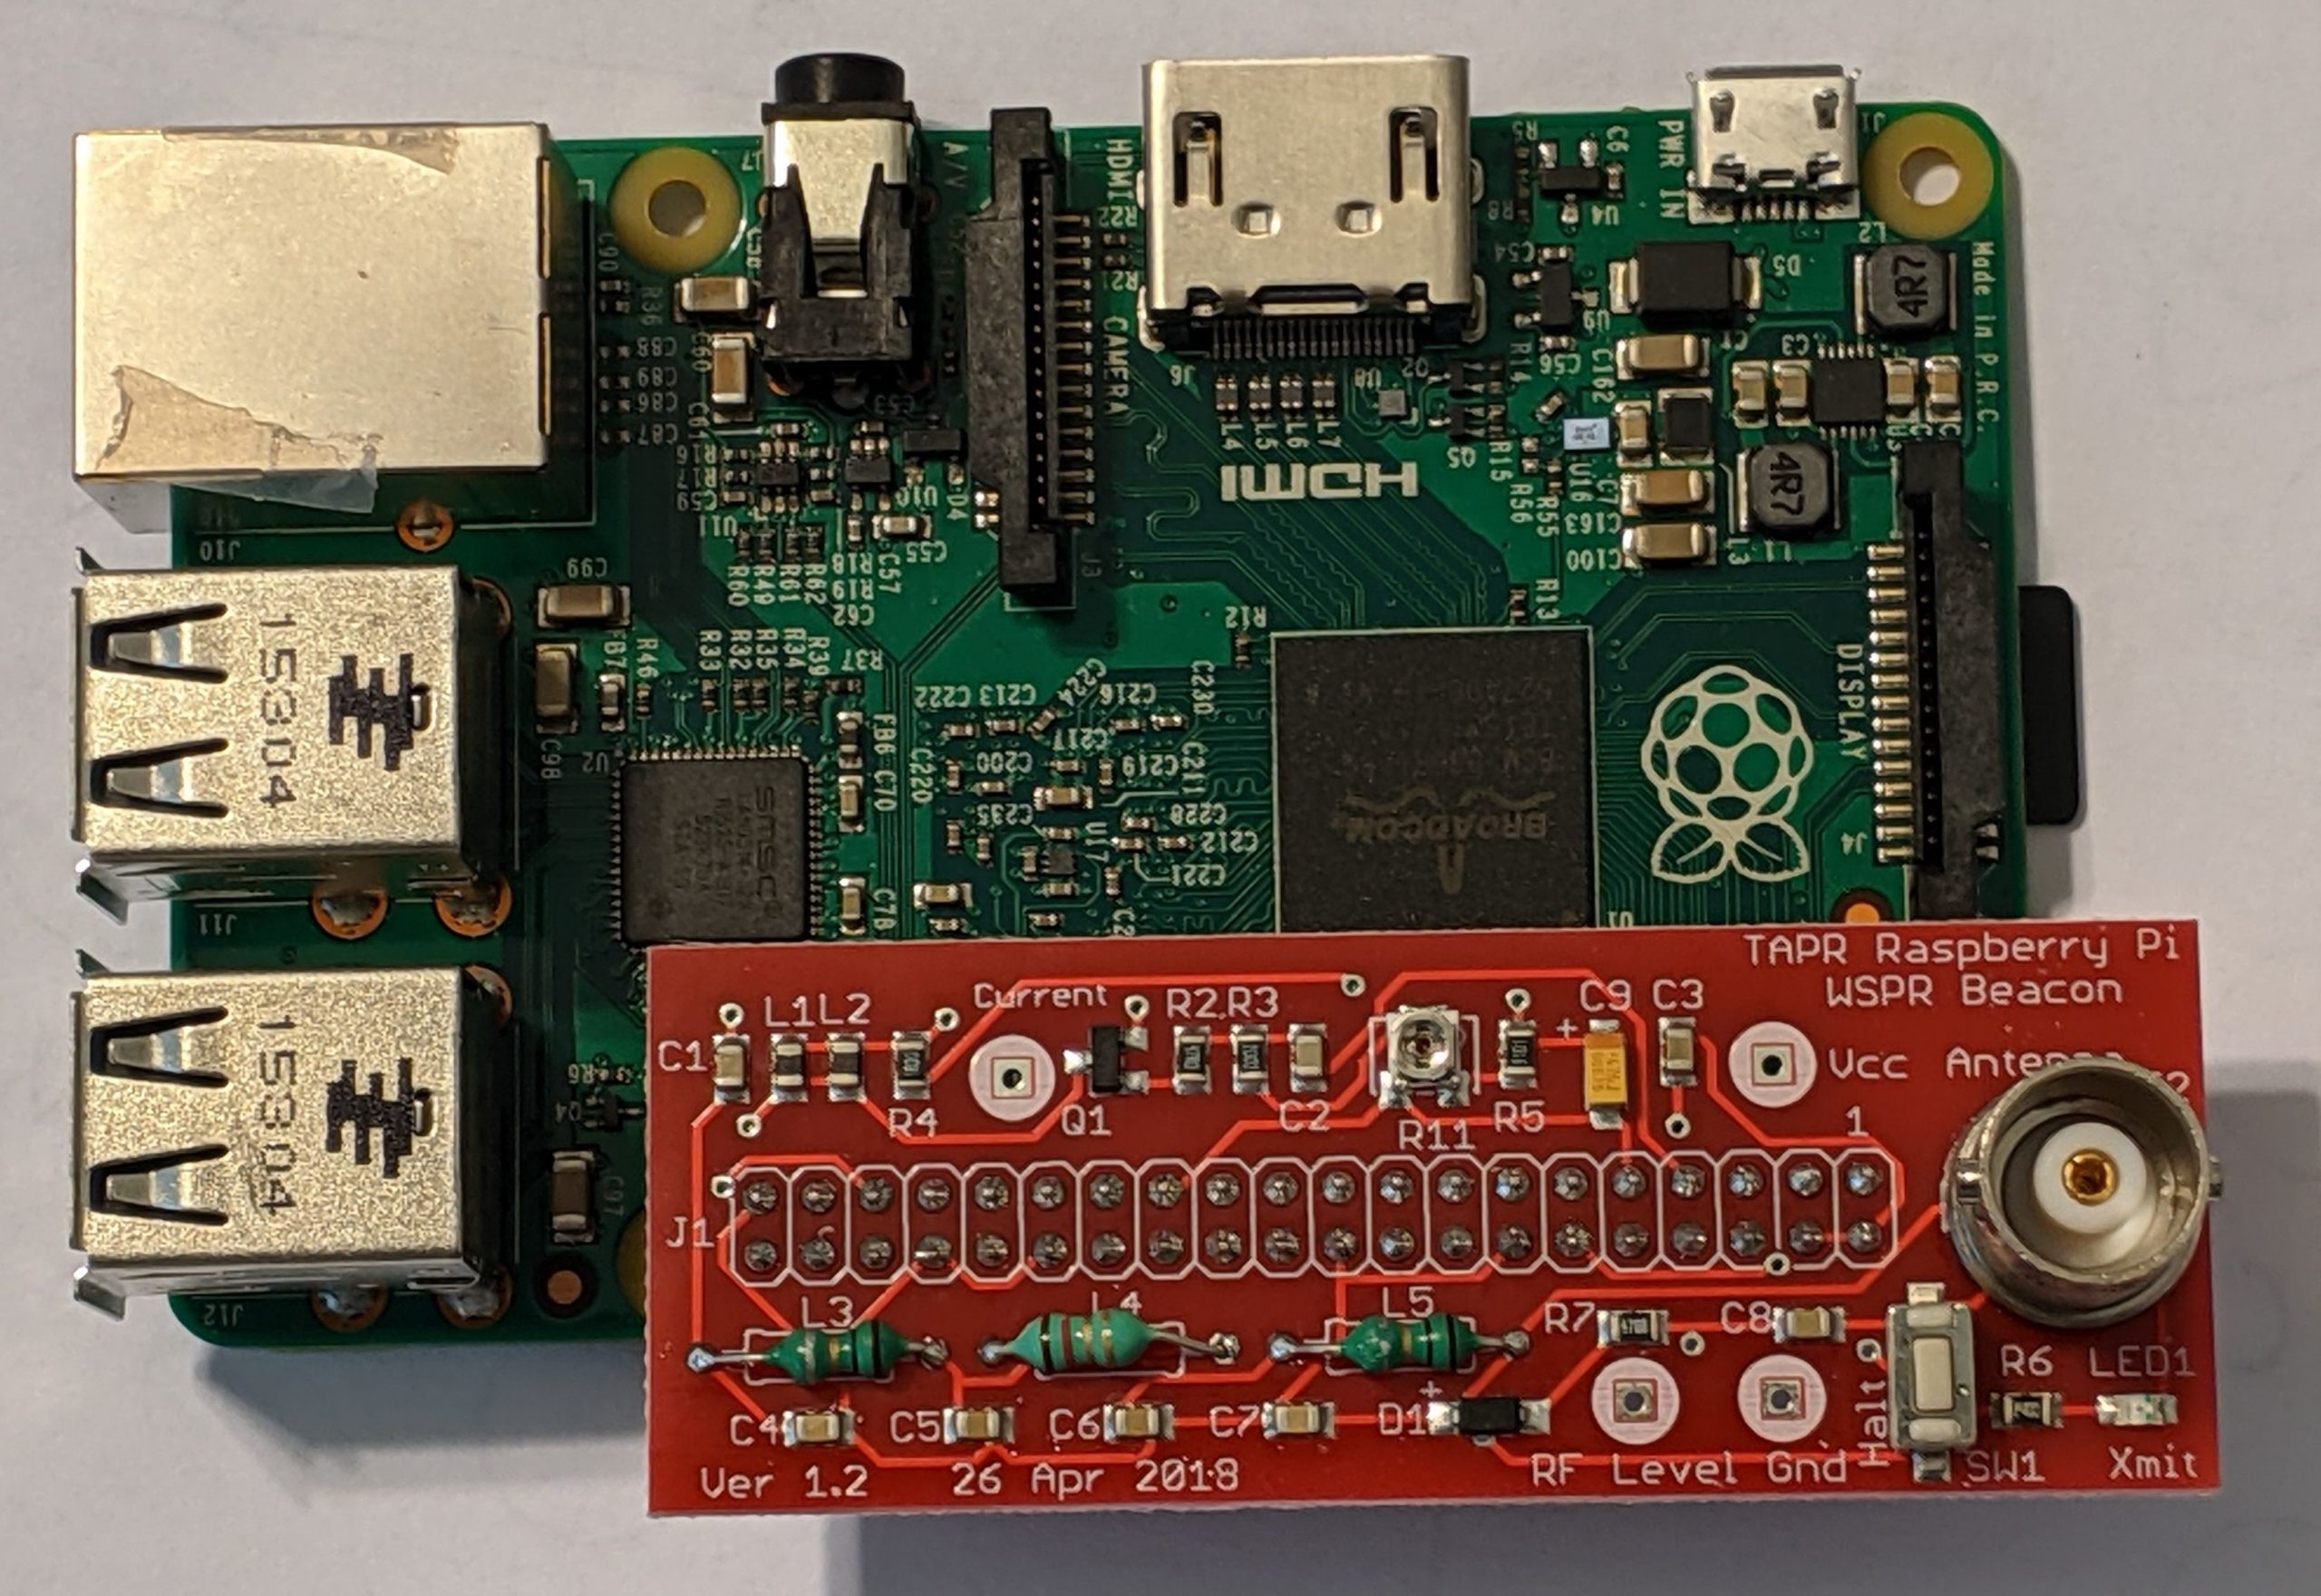
Gladstone Signal Spotting Challenge
A commonly used mode, whose data is useful for visualization, is WSPR (Weak Signal Propagation Reporter, c. 2010)
We are also promoting FST4W, a newer mode (c. 2020) which should yield a richer data set
Equipment needs are very simple - racks full of gear are definitely not required!
Simple Raspberry Pi based WSPR
Transmitter, courtesy https://tapr.org

Slide 23
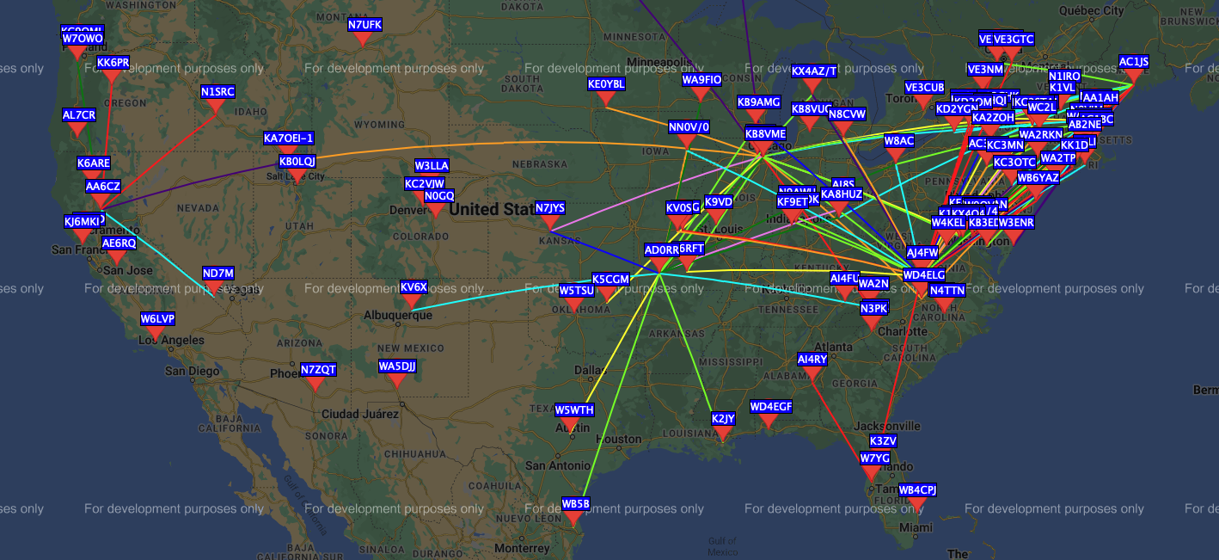
Map of Signal Spotters and Signal Paths
https://www.wsprnet.org/drupal/wsprnet/map

Slide 24
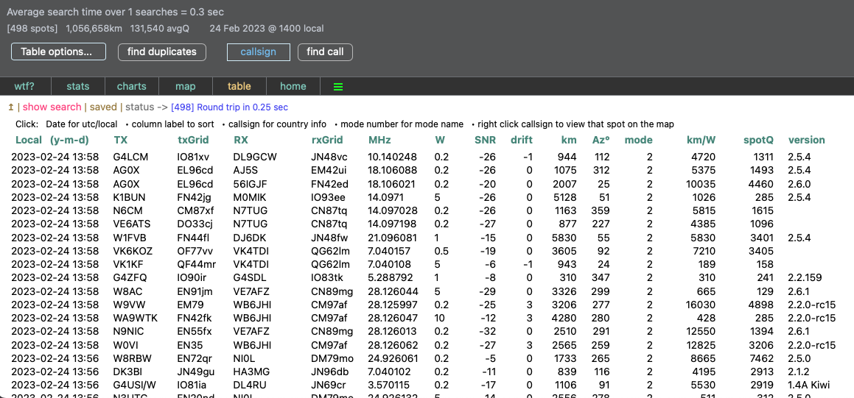
Database of Signal Spots
http://wspr.rocks

Slide 25
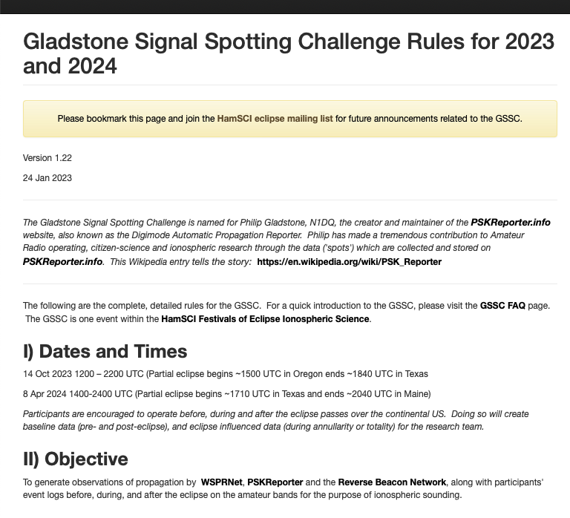
Gladstone Signal Spotting Challenge
We are hoping for significantly higher spot counts in 2023 and 2024
The HamSCI website has details on the Challenge and links to WSPR and FST4W information
https://hamsci.org/contest-info
https://hamsci.org/gssc-faqs
https://hamsci.org/gssc-rules
Results will be published

Slide 26
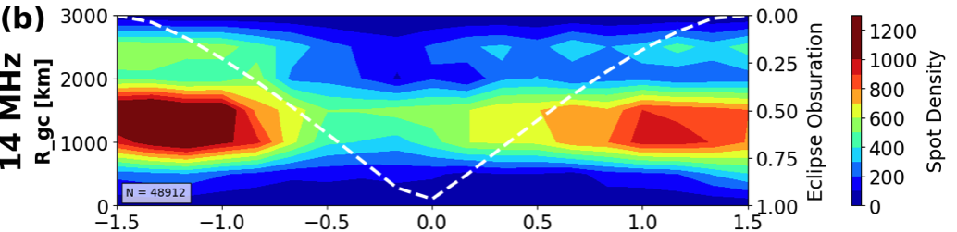
SEQP 2017: RBN Spot Observations
RBN spot observations near the time of totality
Great circle distance between transmitter and receiver versus epoch for frequencies in the amateur radio bands color coded by spot density. For the contours, the underlying grid is 500 km by 10-min bins.
The dashed white line shows obscuration at a representative point 40° N, 100° W (roughly the middle of the continental US).
(Frissell, Nathaniel A., et al. "Modeling amateur radio soundings of the ionospheric response to the 2017 great American eclipse." Geophysical Research Letters 45.10 (2018): 4665-4674.)

Slide 27
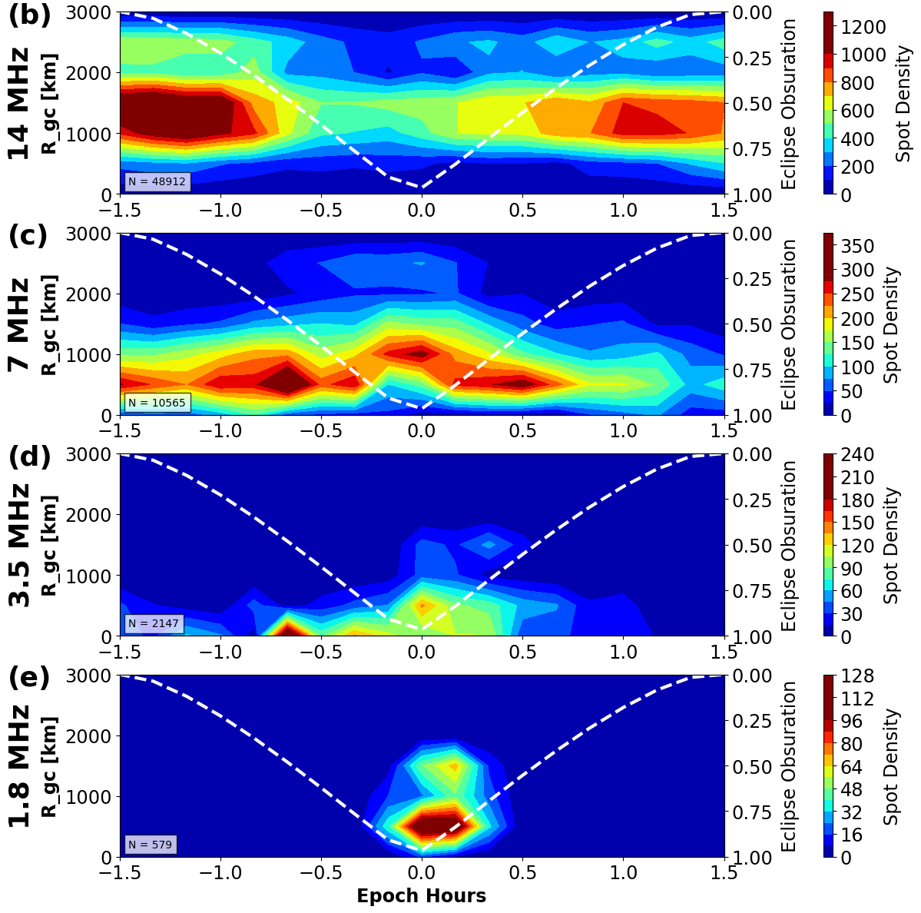
SEQP 2017: RBN Spot Observations
(Frissell et al, 2018)

Slide 28
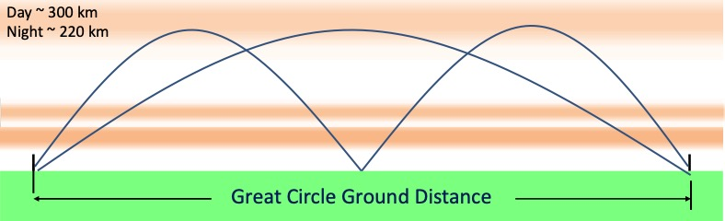

Time Delay of Arrival Event
For the science minded amateur who would like to be part of a controlled experiment
Transmit/receive a ‘chirp signal’, custom generated for your station/callsign, during the eclipses
Measure changes in the observed F2 layer height as the solar eclipse impacts the ionosphere
The HamSCI website has all of the details, including a sign-up form
https://hamsci.org/tdoa-event-2023
Image: S. Cerwin, WA5FRF

Slide 29
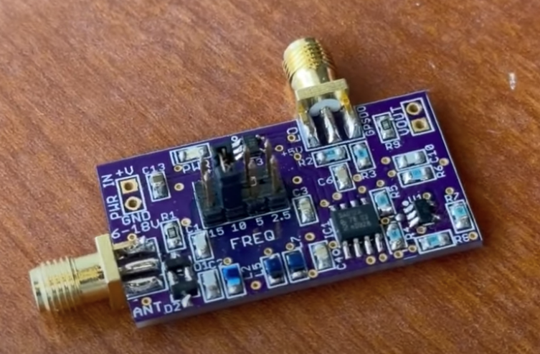
Grape Personal Space Weather Stations
The HamSCI PSWS Project is placing low-cost SDRs in dozens (hundreds?) of locations all across the Americas.
The Grape PSWS serves a very specific purpose: Recording changes in the Earth's ionosphere through measurements of Doppler frequency shifts observed by monitoring, on a 24/7 basis, frequency standard stations such as WWV/H and CHU.
Grape PSWS receiver/mixer board
0.88 x 1.56 inches

Slide 30
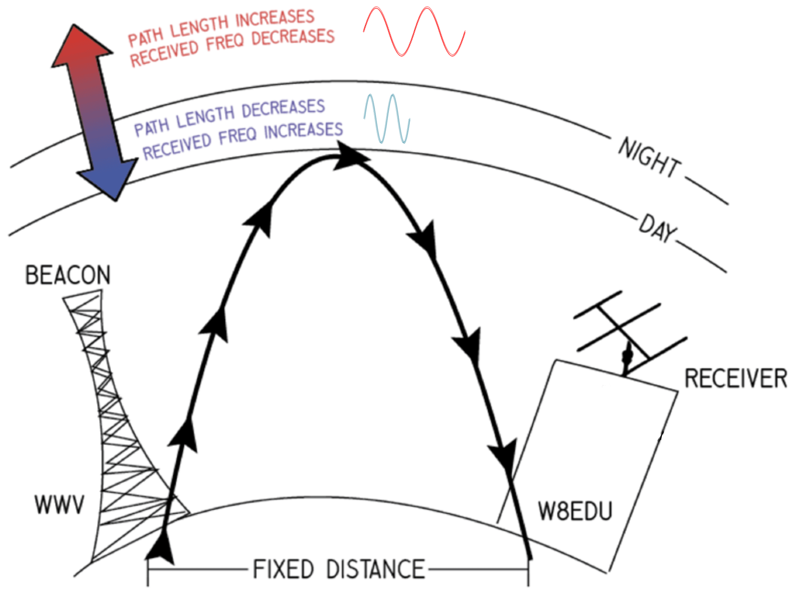
Grape PSWS - For More Information
A full explanation of the science behind the Grape PSWS, and the ways that the Grape system components achieve the scientific goals, are beyond the scope of this talk.
In the simplest of terms, the Sun greatly affects the ionosphere. We can sense the bottomside of the ionosphere by measuring the received frequency of stations such as WWV to milliHertz precision.
Full details on how to build, how to participate and the science behind the PSWS, visit https://hamsci.org/grape
Image: C. Collins, KD8OXT

Slide 31
In Summary: FoEIS is Fun, with a Purpose
Long term benefits of participation
  Improved understanding of HF propagation
  Improved models of the ionosphere
  More accurate propagation forecasts
  And who knows what else? Scientific discoveries are never planned, only experienced.
  Interested in Participating?
Follow HamSCI.org/eclipse and join https://groups.google.com/g/hamsci-eclipse
Pre-register for the events at HamSCI.org/eclipse
Operate in the SEQP, TDOA Event or build a Grape receiver!!!

Slide 32
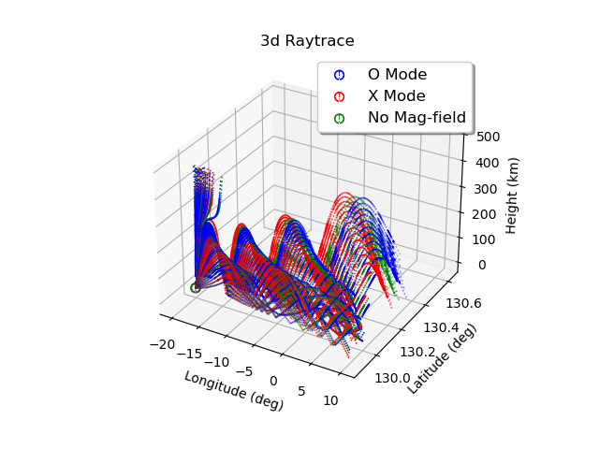
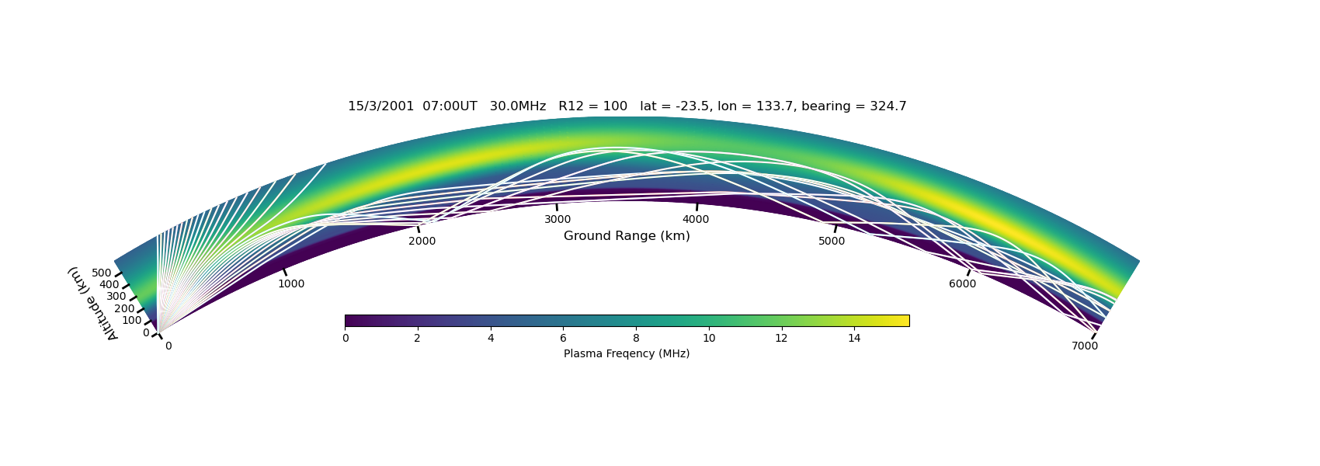
PHaRLAP interface changed to Python
PHaRLAP is an ionosphere raytracing program available for free from the Australian government using MATLAB
PyLap enables using PHaRLAP with Python
https://github.com/HamSCI/PyLap

Slide 33
WWV/WWVH enhanced transmissions
Enhance scientific use of WWV/WWVH. https://www.hamsci.org/wwv
10 second voice announcement.
Gaussian white noise (2 seconds).
One second blank time.
Phase-coherent 2, 3, 4, 5 kHz sine waves that drop down by 3 dB 9 times, 10 seconds total.
One second blank time.
An eight-second sequence consisting of linear up-chirps and down-chirps, generated
2 seconds blank time.
A one-cycle burst at 2.5 kHz frequency, for time domain measurement, repeated 5 times over the course of 1 second; then the same for 5 kHz.
One second blank time.
Repeated 2 seconds of Gaussian white noise for synchronization. Same sequence.
3 seconds blank time.

Slide 34
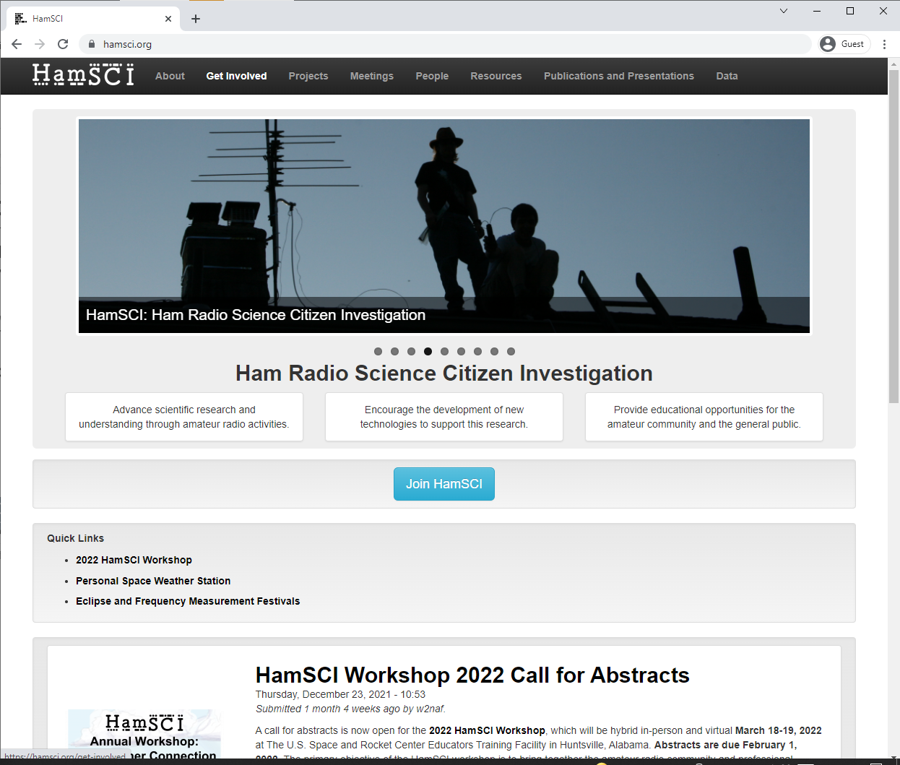
Getting Involved
HamSCI now has over 800 members!
Join by visiting hamsci.org
Main Google group is open discussion for all things related to HamSCI.
Many specialized email lists and telecons, too!
Yearly 2 day hybrid workshop

Slide 35

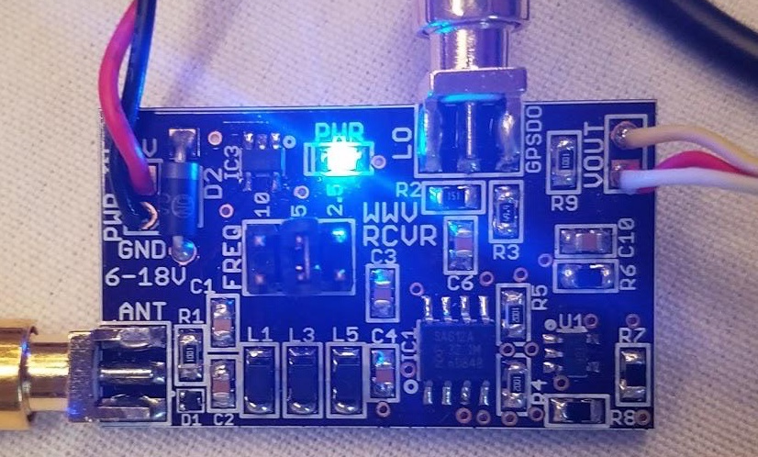

HamSCI Zoom Telecons
TangerineSDR Telecon | Engineering telecon to support the TangerineSDR and magnetometer board development. | Mondays at 9 PM Eastern (Tuesdays 0100z)
Grape Telecon | Telecon to support engineering and science related to the Grape (low-cost) Personal Space Weather Station. | Thursdays at 10 AM Eastern (1400z)
SEQP Telecon | Telecon to support the 2023 and 2024 Solar Eclipse QSO Parties. | Thursdays at 4 PM Eastern (2000z)
Zoom links and calendar at http://hamsci.org/get-involved.

Slide 36
Acknowledgments
We are especially grateful for the
support of NSF Grants AGS-2002278, AGS-1932997, AGS-1932972, AGS-2045755,
AGS-2230345, and AGS-2230346.
support of the NASA SWO2R Grant 80NSSC21K1772.
support of Amateur Radio Digital Communication (ARDC).
amateur radio community volunteers who have contributed to HamSCI projects.
amateur radio community who voluntarily produced and provided the HF radio observations used in this paper, especially the operators of the Reverse Beacon Network (RBN, reversebeacon.net), the Weak Signal Propagation Reporting Network (WSPRNet, wsprnet.org),
PSKReporter (pskreporter.info) qrz.com, and hamcall.net.
use of the Free Open Source Software projects used in this analysis: Ubuntu Linux, python (van Rossum, 1995), matplotlib (Hunter, 2007), NumPy (Oliphant, 2007), SciPy (Jones et al., 2001), pandas (McKinney, 2010), xarray (Hoyer & Hamman, 2017), iPython (Pérez & Granger, 2007), and others (e.g., Millman & Aivazis, 2011).

Slide 37
Acknowledgments
Nathaniel A. Frissell W2NAF
The University of Scranton
Gary Mikitin, AF8A
Ed Efchak, WX2R
And the HamSCI Community

Slide 38
Thank you!

