Slide 1

University-Class
Open Ground Station
Building a transmit capable open source
ground station network
Glenn LeBrasseur (KJ7SU), Anna Meneely (KM7CIT)
and like a billion other students
Portland State Aerospace Society at Portland State University
1900 SW 4th Avenue ste 160, Portland, OR 97201
503-708-7711 / adg4@pdx.edu
Notes:
Introduce yourself

Slide 2
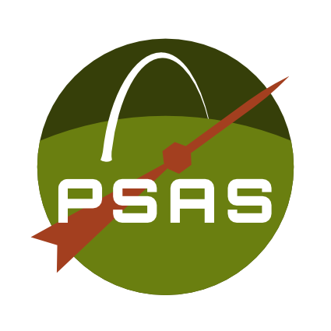
PSAS
Portland State Aerospace Society

Slide 3
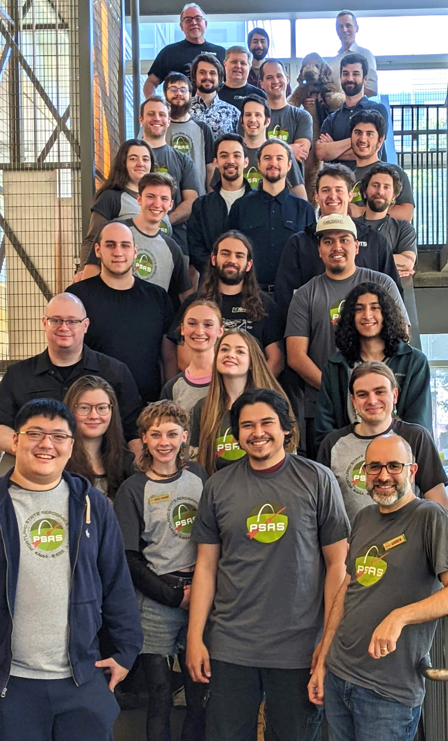
Open Source Space Hipsters
Extracurricular interdisciplinary team-based
experiential student aerospace project
Militantly interdisciplinary
  ME/EE/CS + business + math + psychology + physics + …
Completely open source
Badly funded
  Crowdfunding
  NASA Oregon Space Grant Consortium (thank you!)
We have no idea what we’re doing
Notes:
Not just PSU students but PCC, industry advisors, high school students, community, around the world

Slide 4
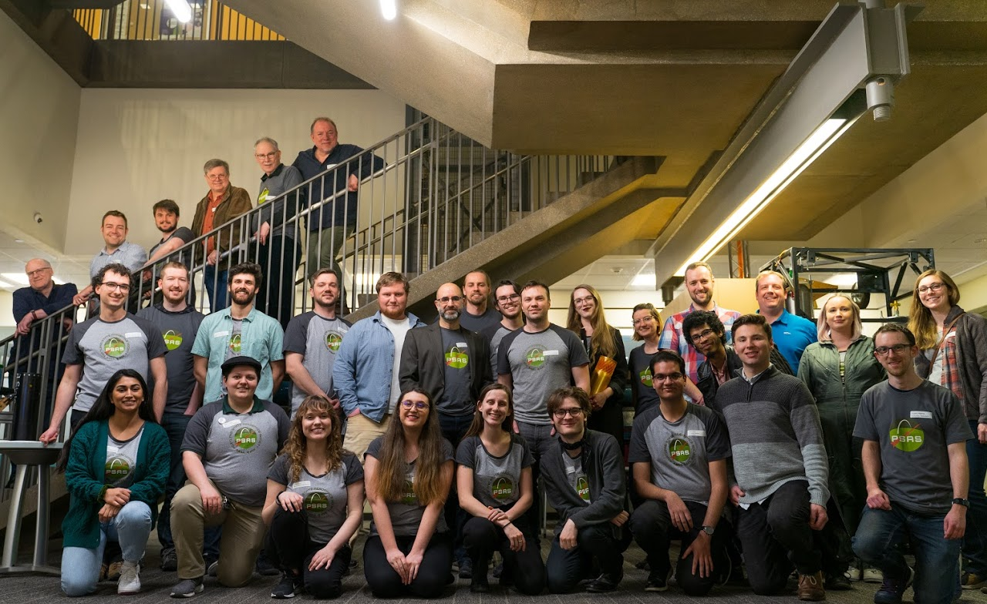
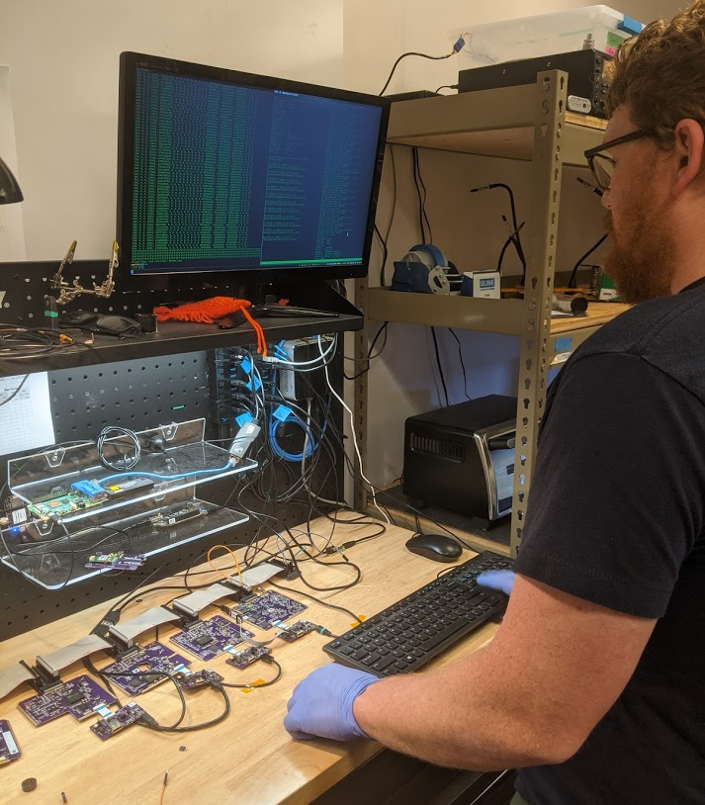
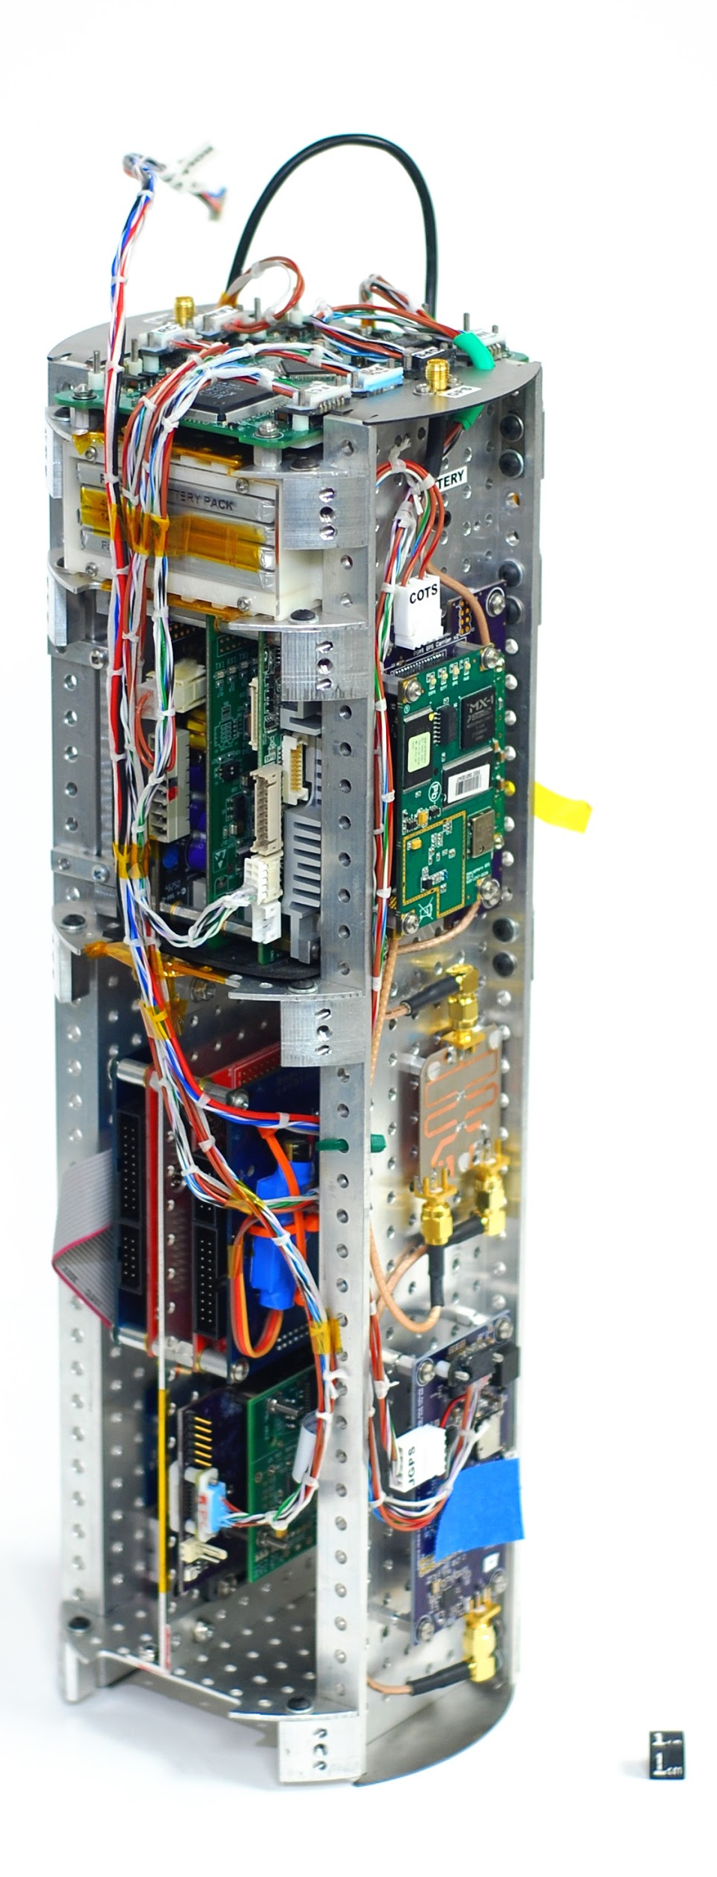
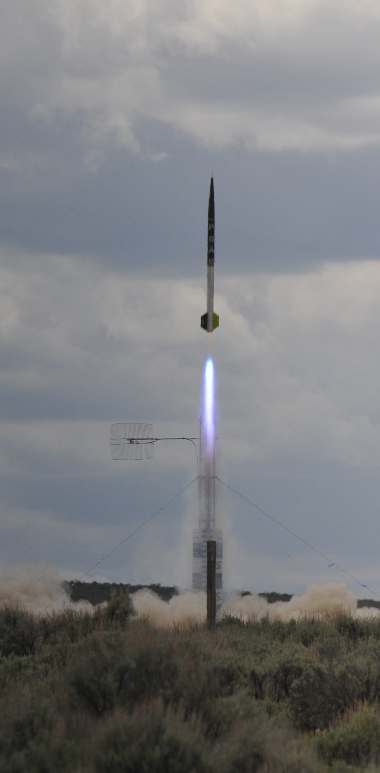
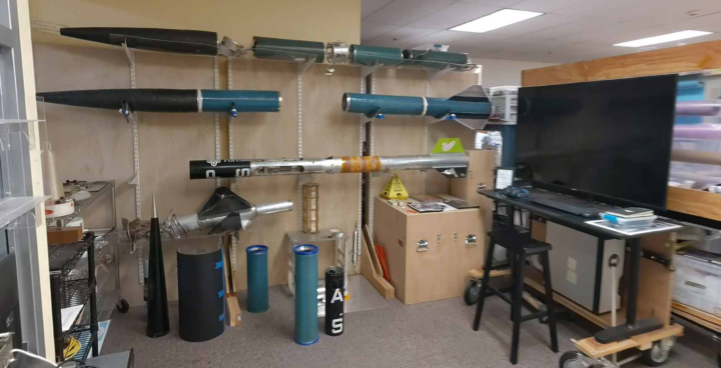
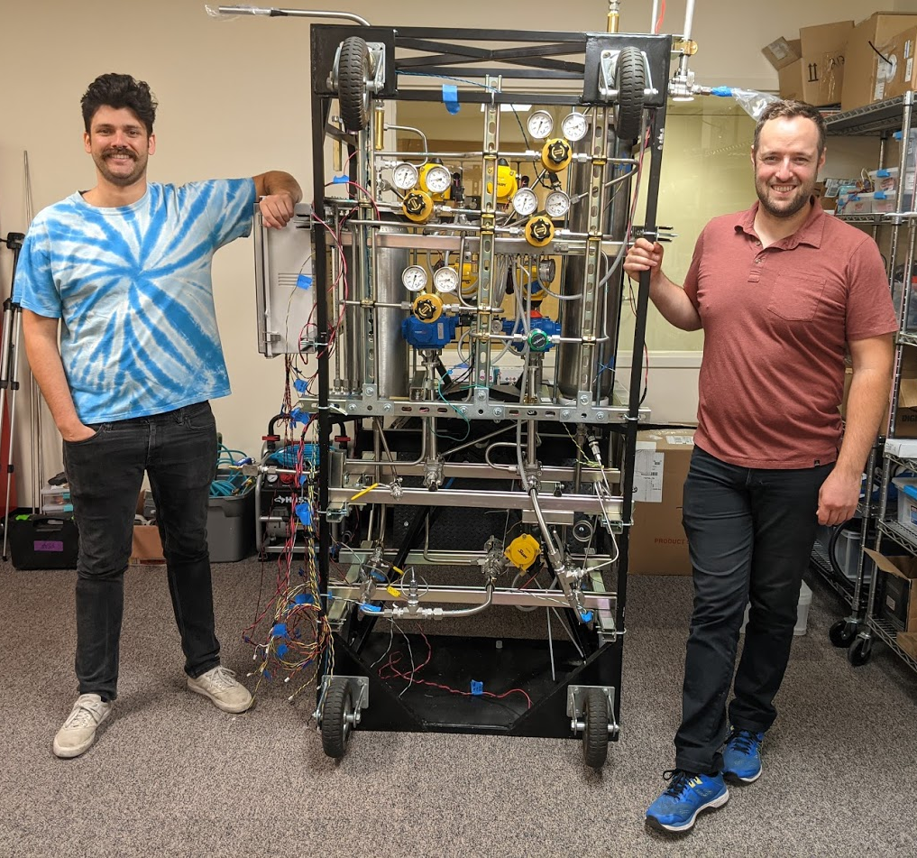

Slide 5
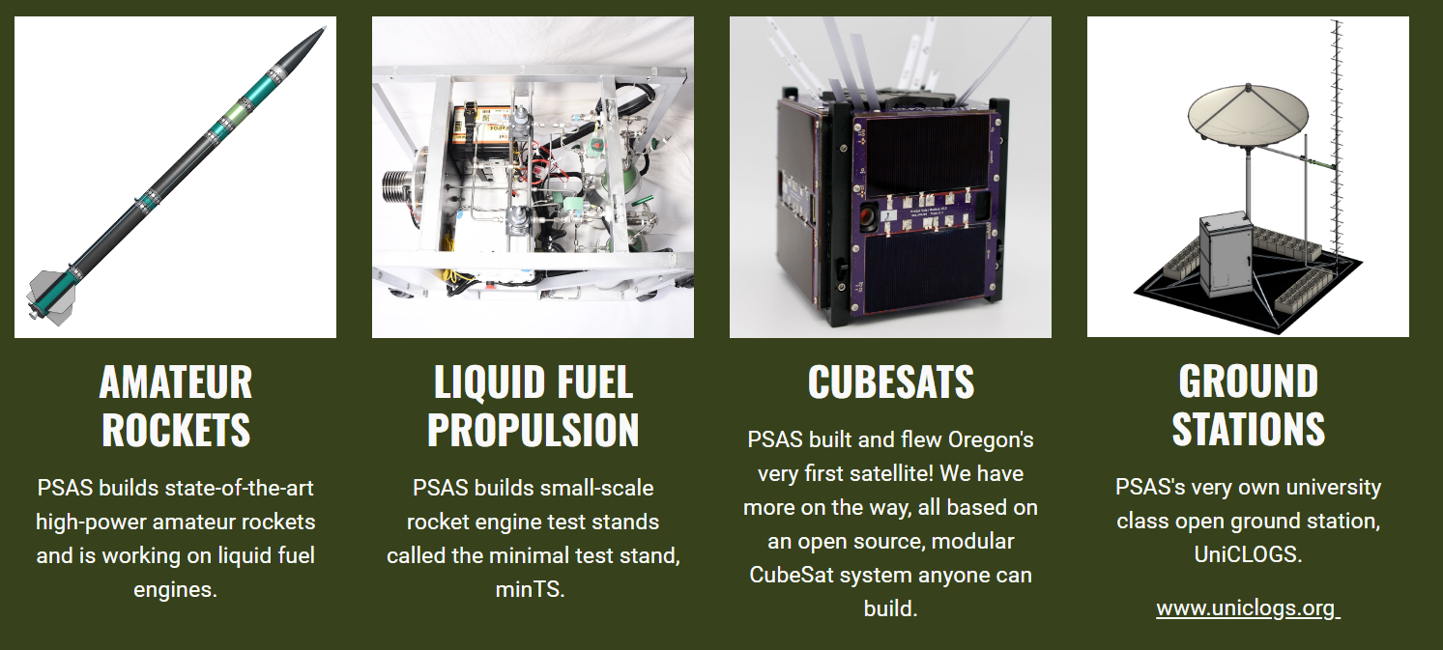
PSAS Projects

Slide 6
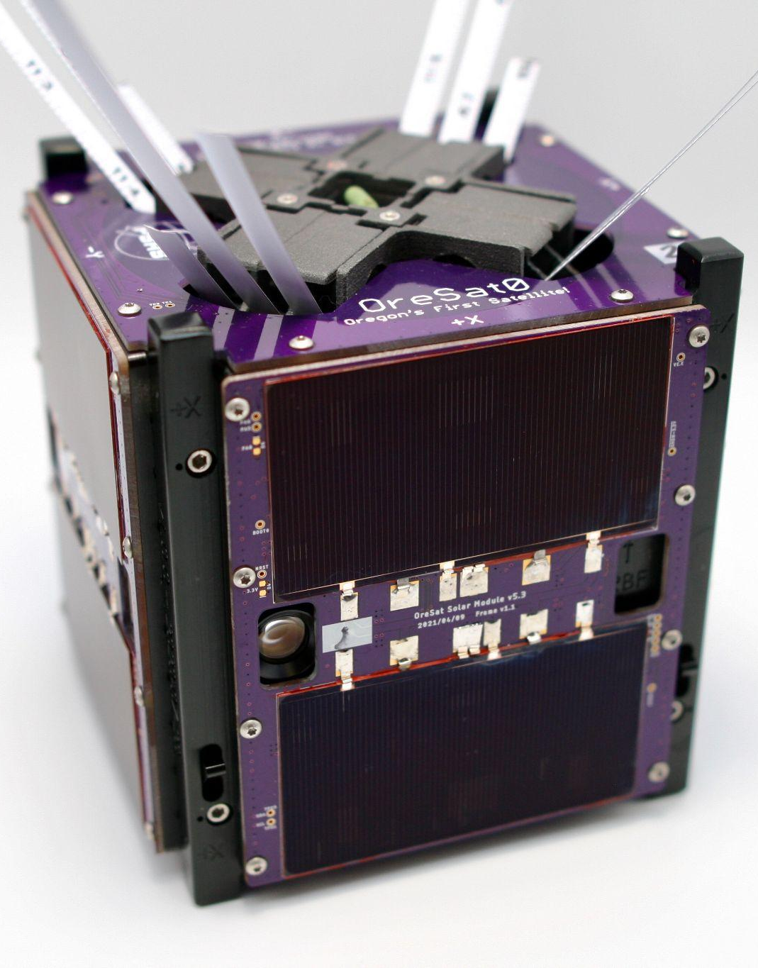

OreSat0, Oregon’s first satellite
Mission: Don’t catch fire in space
Launched March 15th, 2022 on Astra LV0009
525 km D2D SSO
THANK YOU
FOR THE RIDE!
Notes:
1st sat, 1U, ty for spaceflight, still in orbit; C3 / PVs / Battery

Slide 7
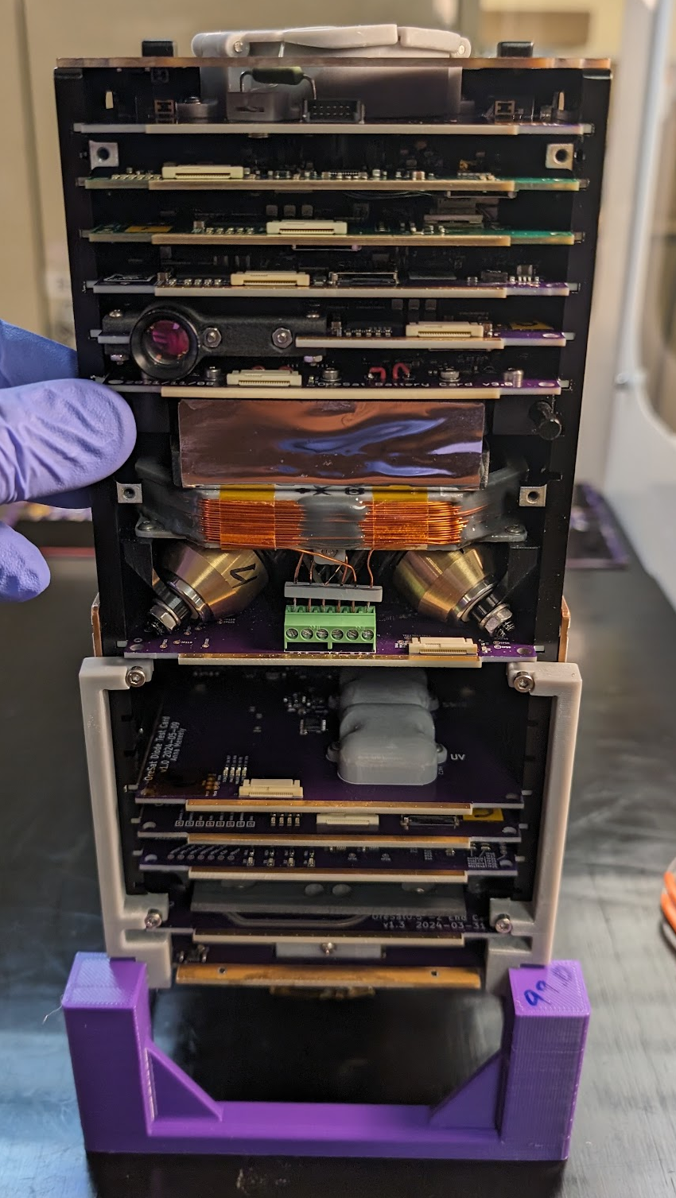
OreSat0.5
Still “technology demonstration”
Test the:
  S band helical antenna
  Attitude Determination and Control System (ADCS)
  Cirrus Flux Camera engineering unit
Demonstrate critical technologies
needed for OreSat1, a CSLI mission
Notes:
focus on system ADCS system

Slide 8
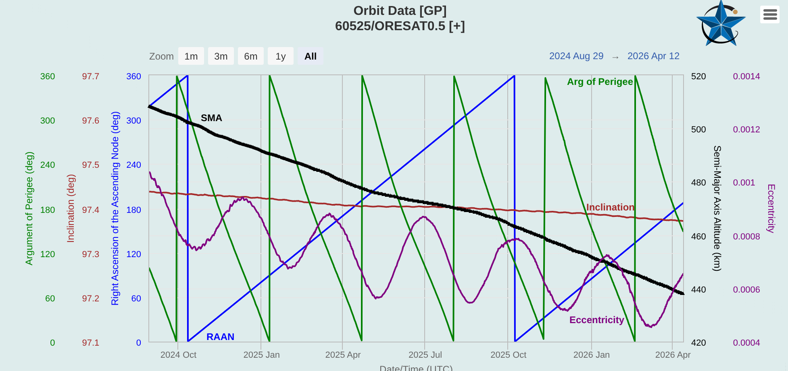
Notes:
Still above ISS
Look at black line - 436 km
Running into rarified atmos in LEO.
Cause noe orbital propulsion, we spiral in (200km) which is our de-orbit

Slide 9
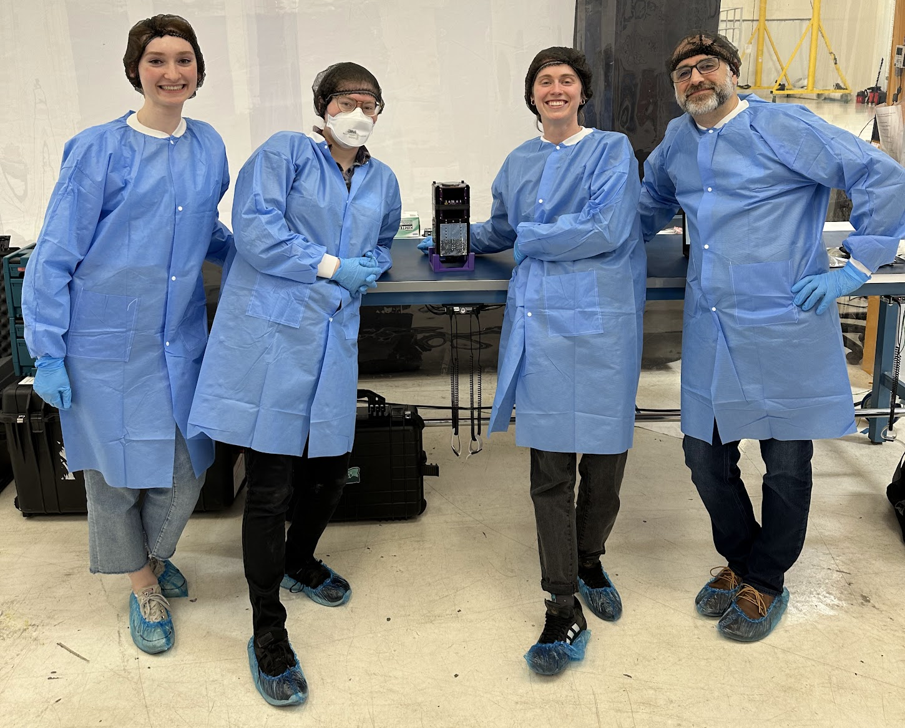

OreSat0.5
Launched August 16, 2024 to LEO
525 km SSO
THANK YOU
FOR THE RIDE!
Notes:
Add deorbit path
We can do an OreSat, 0.5, 1 satellite presentation at another time!

Slide 10
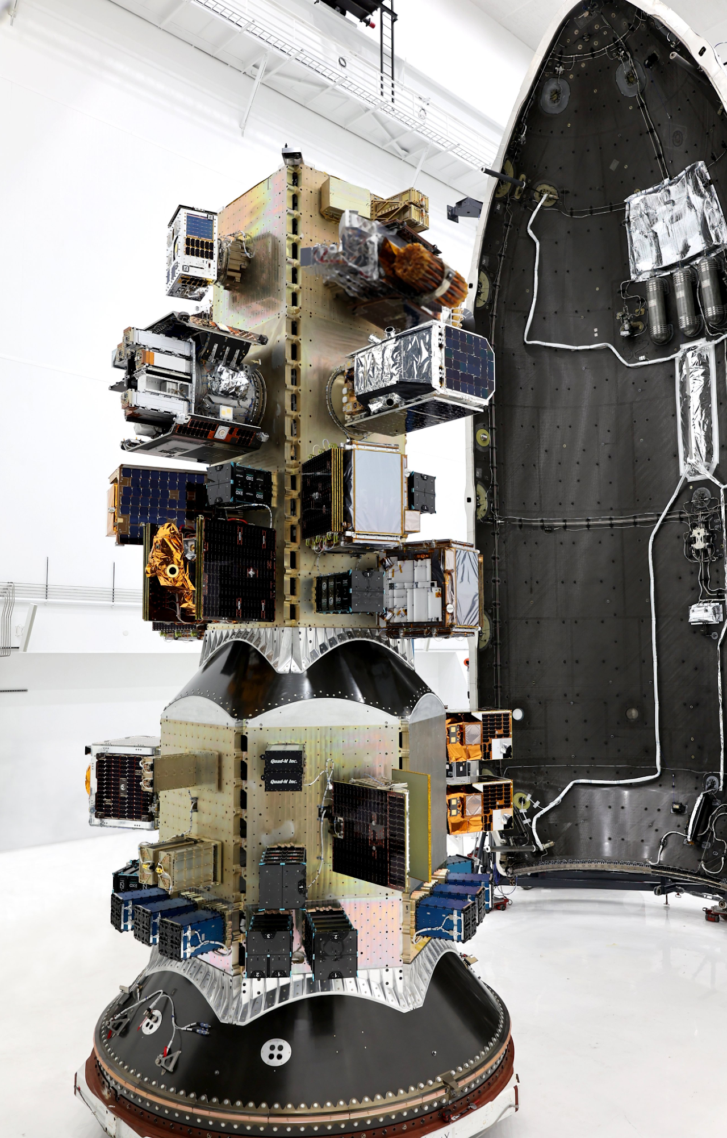
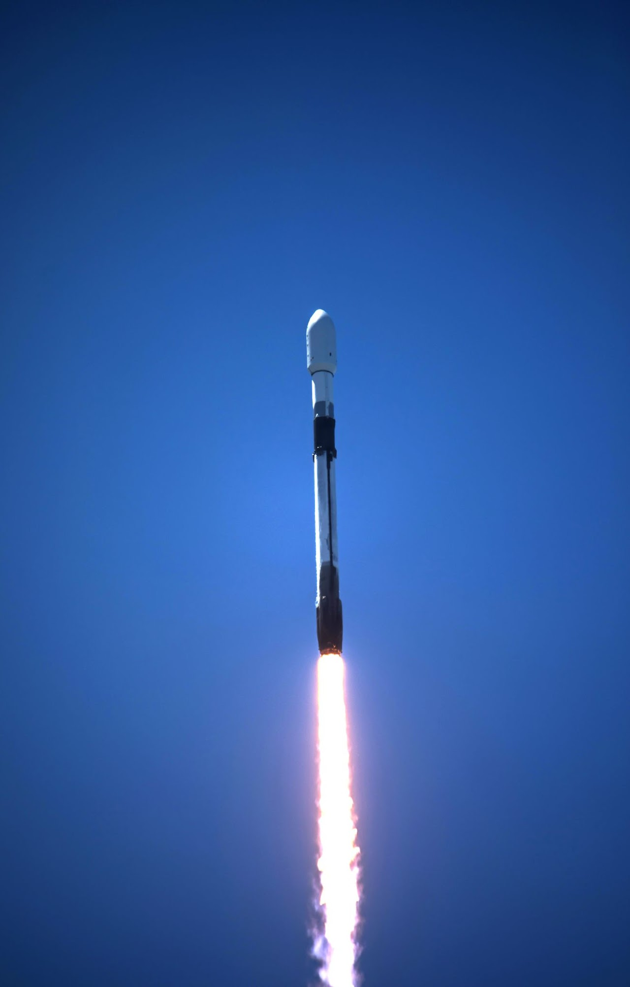
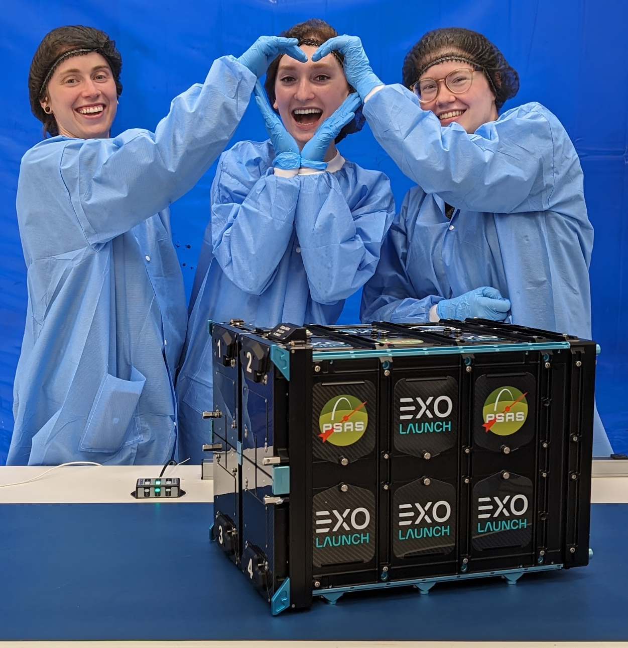

Slide 11
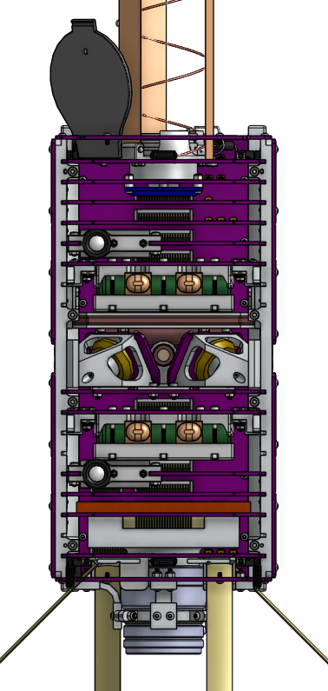
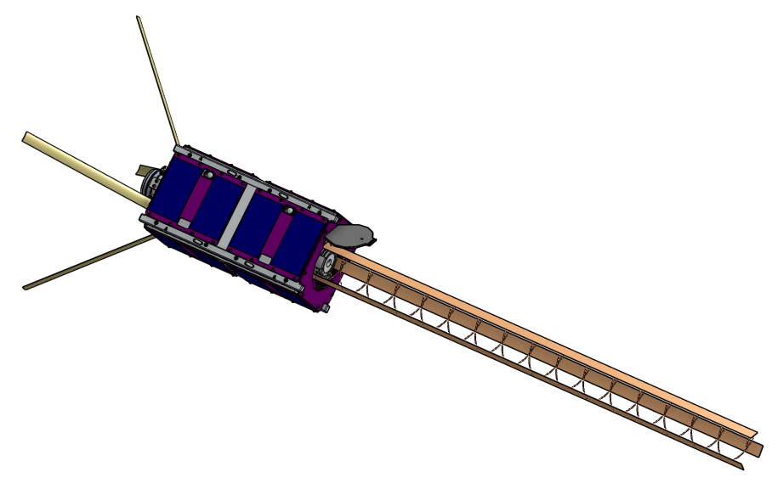
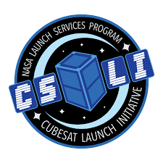
OreSat1
ISS Deployment on NG-25
NET January 2027
THANK YOU TO
FOR THE RIDE!
Notes:
CSLI ISS Resupply
CubeSat Launch Initiative

Slide 12
On the Shoulders of Giants
Notes:
Explain: The concept of open source ground station is not by any means new, we are building on the amazing existing work or “standing on the shoulders of giants” so to speak, of Satnogs

Slide 13

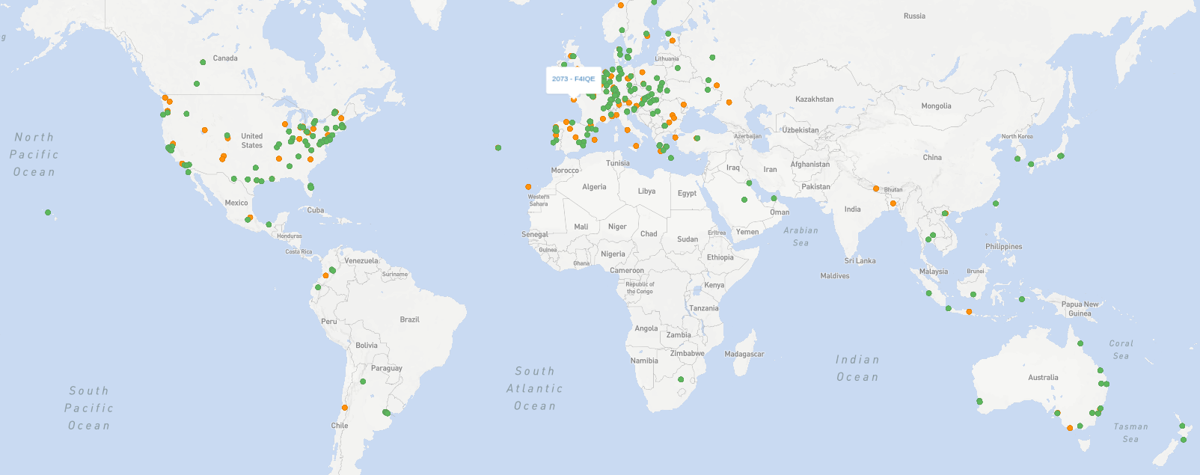
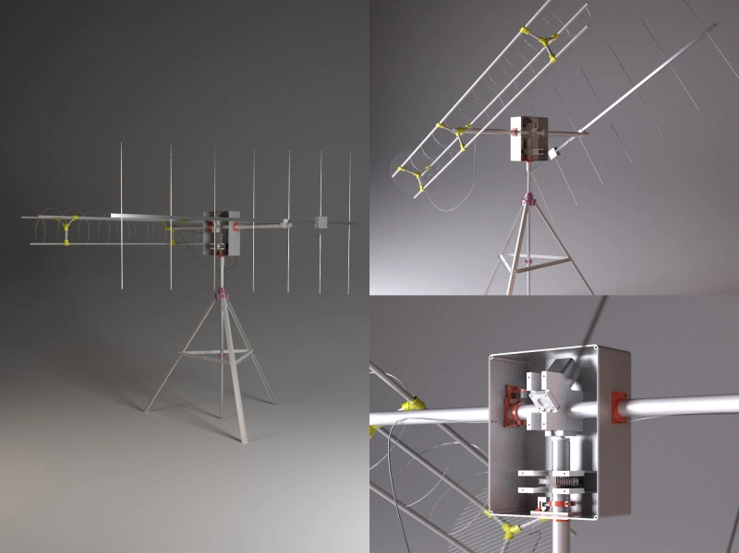
Satellite Networked Open Ground Station
A
Notes:
SatNOGS is free open source software and hardware platform aimed to create a global satellite ground station network created by Libre Space Foundation
Build your own!!
Thousands of LEO cubesats rely on this network, it’s amazing!

Slide 14
SatNOGS
Working global network of ground stations, for free!
Incredible resource for small sats
Decodes data packets
Actively matches deployed orbital objects to satellite catalog
It’s only drawback: RX only
  International licensing for TX is hard
OreSat0 Example…
Notes:
QR code

Slide 15
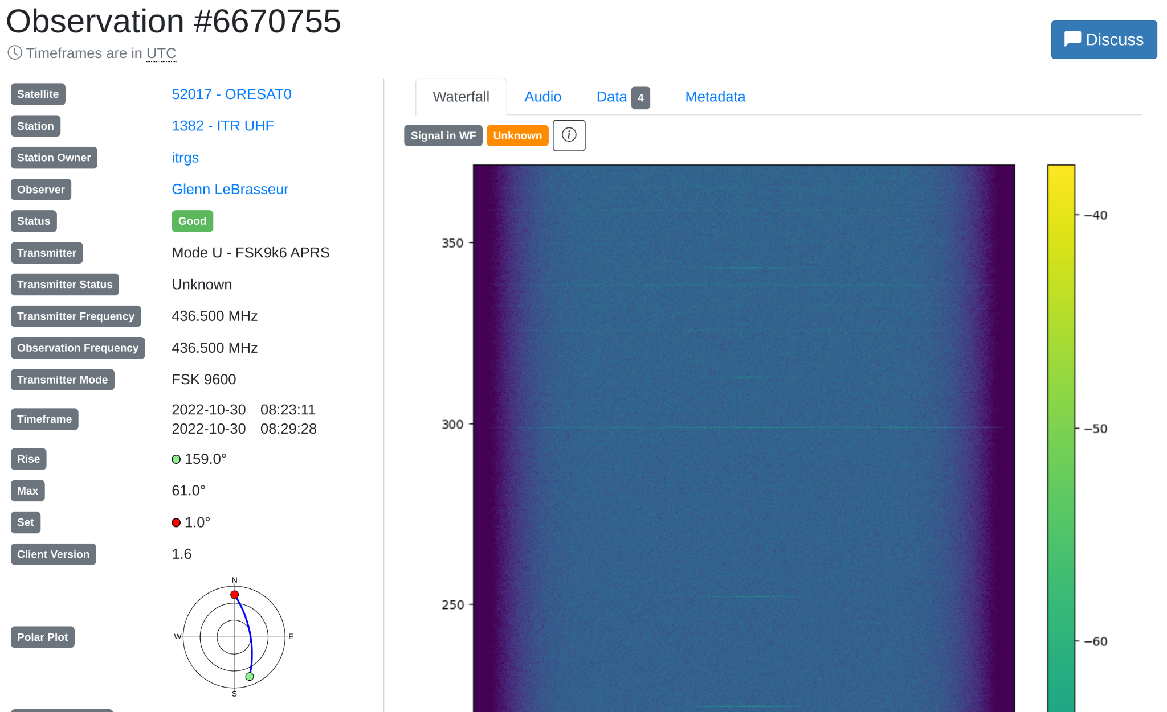
Notes:
Here’s an OreSat0 pass on SatNOGS showing the RF waterfall plot of the OreSat0 beacon - you can see the little dashes of OreSat0’s beacon.

Slide 16
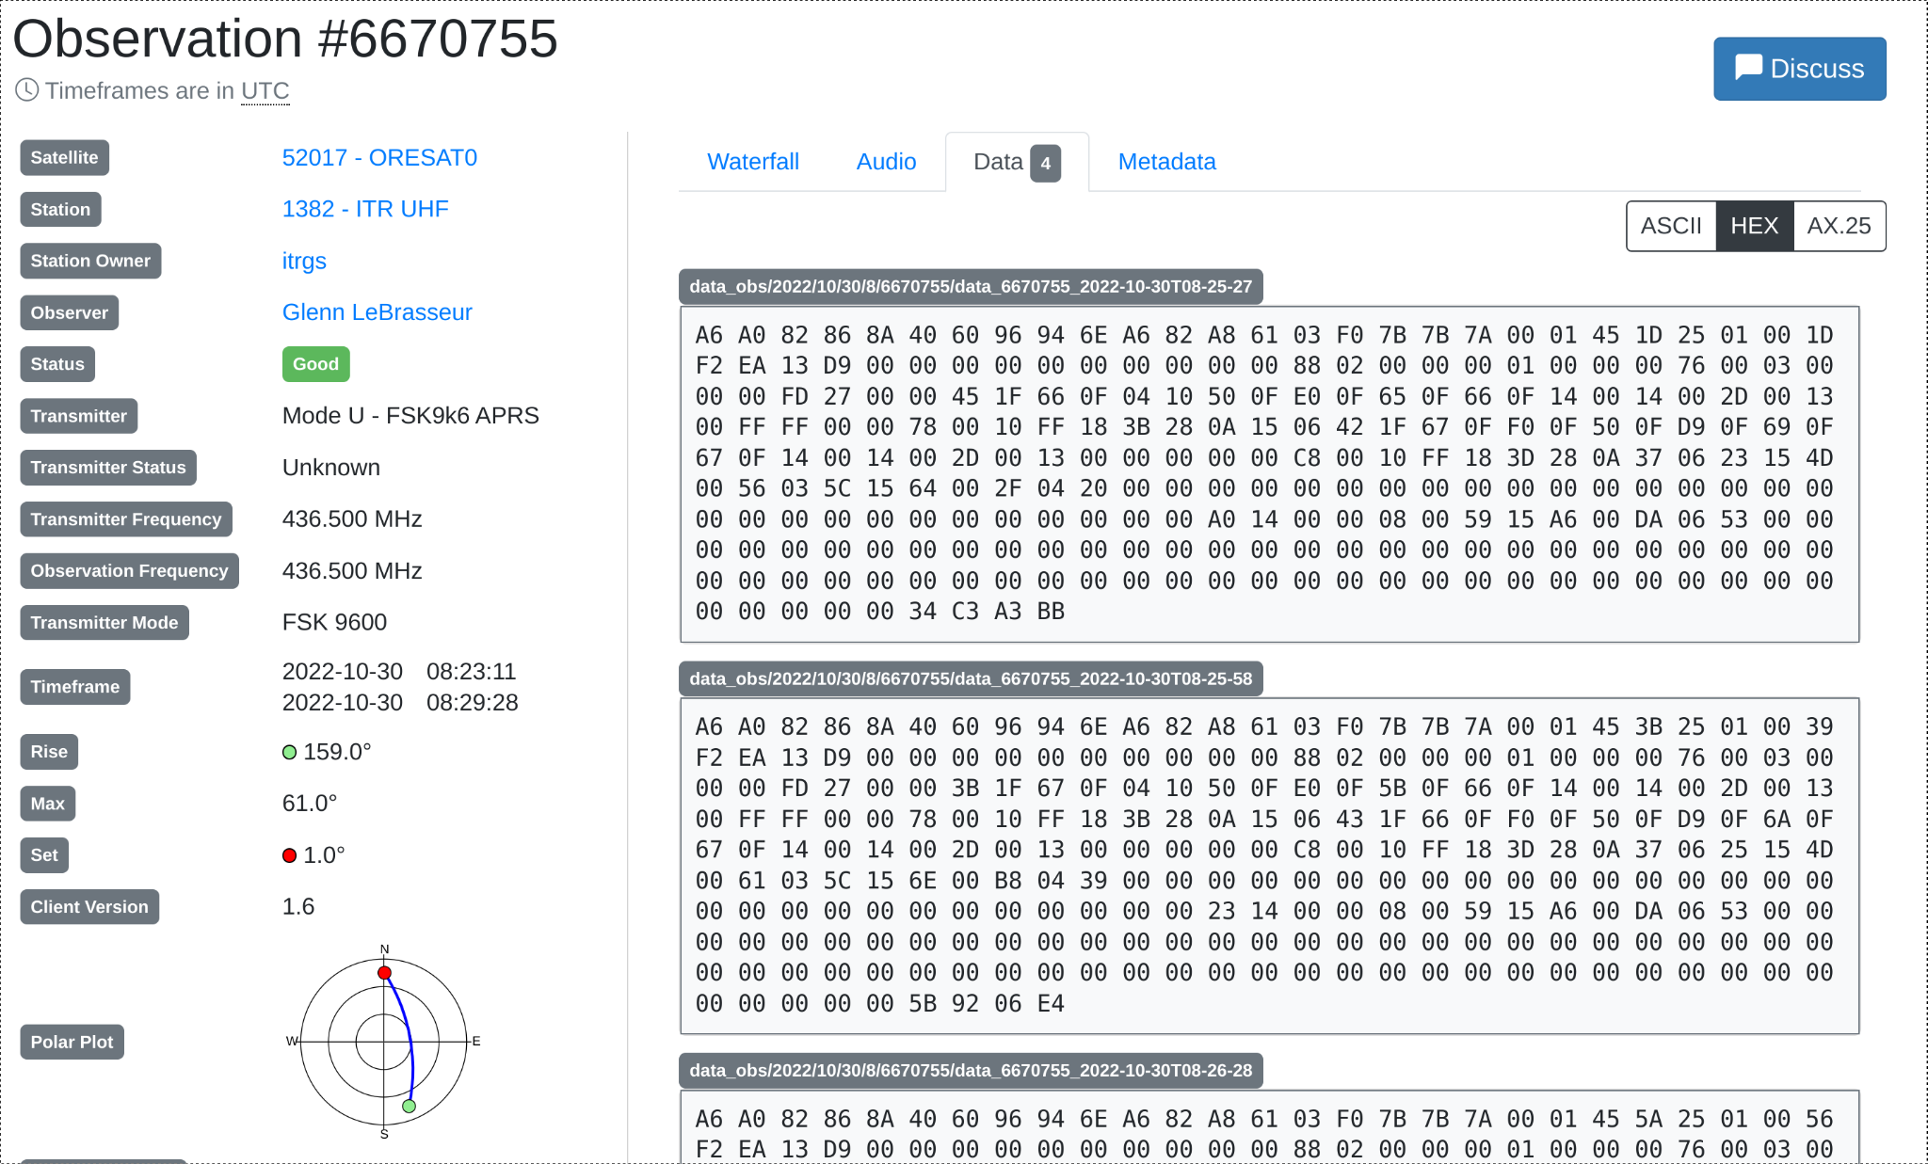
Notes:
Here’s that same pass, but with the beacon data decoded by SatNOGS
AX.25, APRS

Slide 17
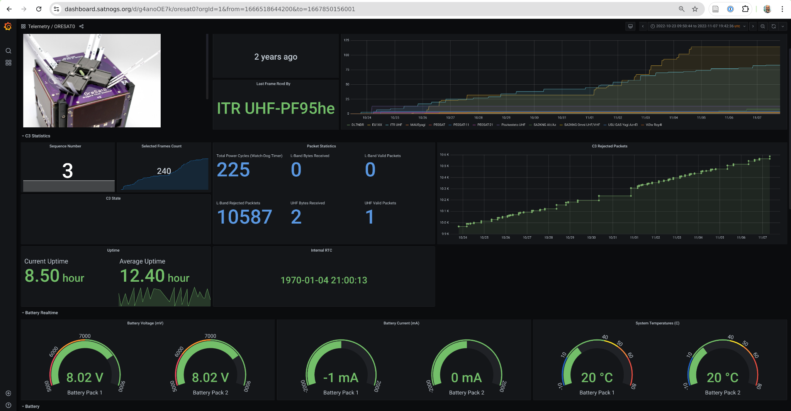
Notes:
And EVEN a dashboard showing OreSat0’s data, all part of SatNOGS

Slide 18
Goldilocks dusk to dawn orbit, always in sunshine :D
LNA enable, TX turns on LNA, RX turns off LNA
Biasing inductor on front end, critically boars, broke into oscillation

Slide 19
Adding Transmit

Slide 20

Previous but inactive ground station projects
ESA’s Global Educational Network for Satellite Operations (GENSO)
Stanford Space Systems Development Lab’s (Mercury)
  Lots of other one-off ground stations, including amateur radio stations
Third time a charm?
Notes:
We’re not the first to have this have this idea; unfortunately all are defunct as far as we know.

Slide 21
UniClOGS
University Class
Open Ground Stations

Slide 22
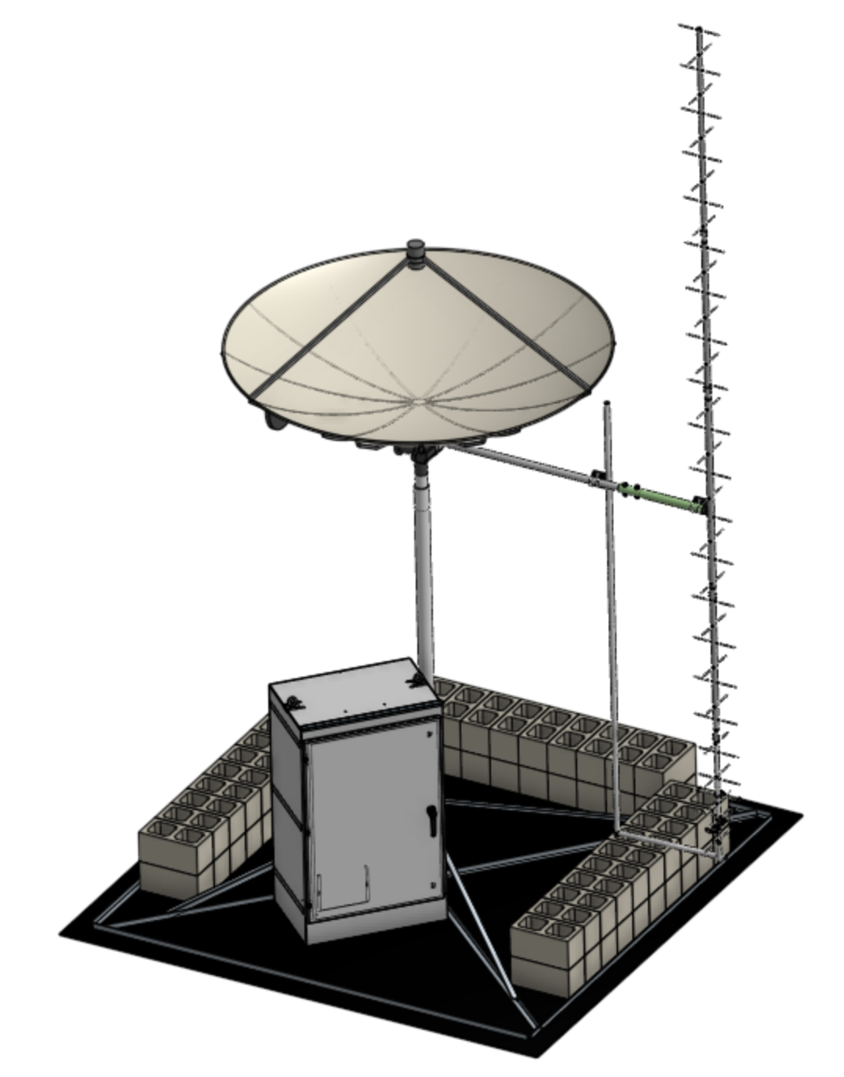
UniClOGS
Choose your own adventure
open source, amateur radio-based
ground station project
Multi-band transmit and receive capabilities
Includes actual documentation
  BOM, build, installation, test, operation
Open source software
Notes:
Tailoring to mission requirements

Slide 23
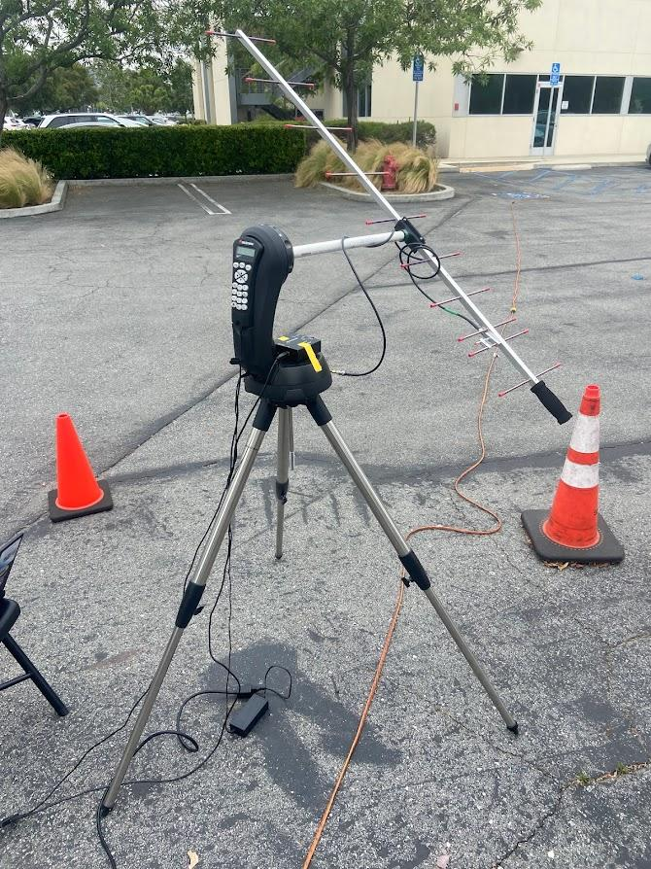
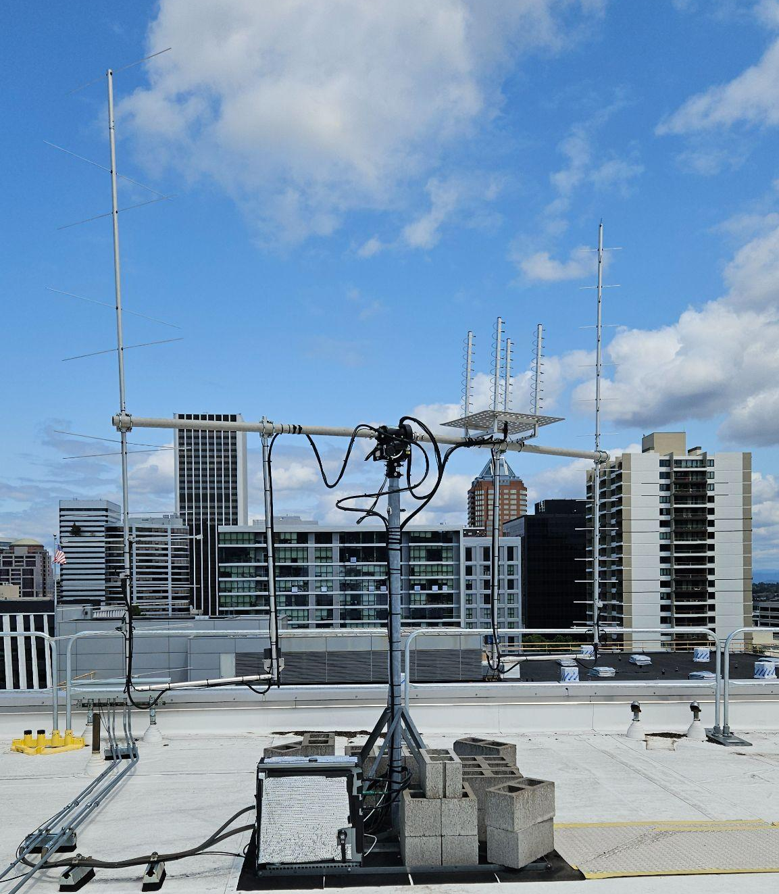
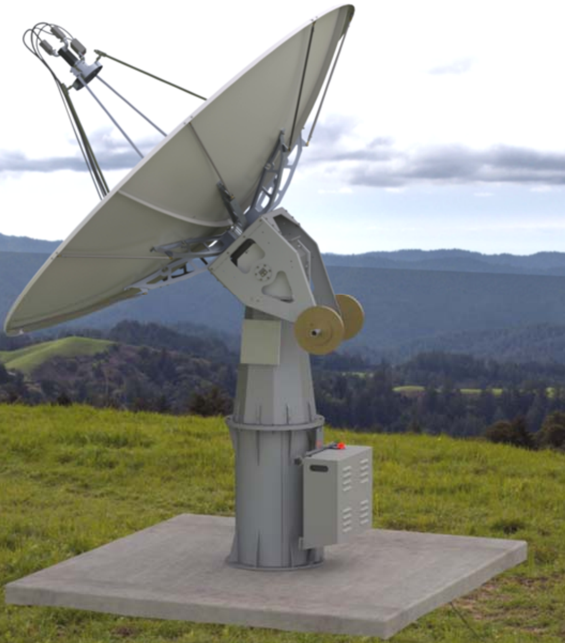
Driving Factor: Cost
Balances performance, reliability, and price for small organizations
CPP Bronco Space “Pointy”
< $1000
UniClOGS
$10,000 - $25,000
M² Antenna Systems
> $170k
Notes:
WE LOVE POINTY!!! But it isn’t reliable and doesn’t have enough antennas. We want the M2 dish but we can’t afford it. Thus UniClOGS.

Slide 24


Driving Factor: Open Source
Configurable
Reduce barrier to entry for university CubeSat groups
Accessible and reproducible
  Standard tooling
  Easy assembly steps
  Instructions aimed at inexperienced assemblers
But still “Commercial strength”

Slide 25


Driving Factor: Amateur Radio
Each station is licensed by an amateur radio operator
Allows for international cooperation through
reciprocal agreements
Notes:
Licensing is simplified by AR; allows for international cooperation and coordination of UniClOGS stations

Slide 26
Choose your UniClOGS

Slide 27
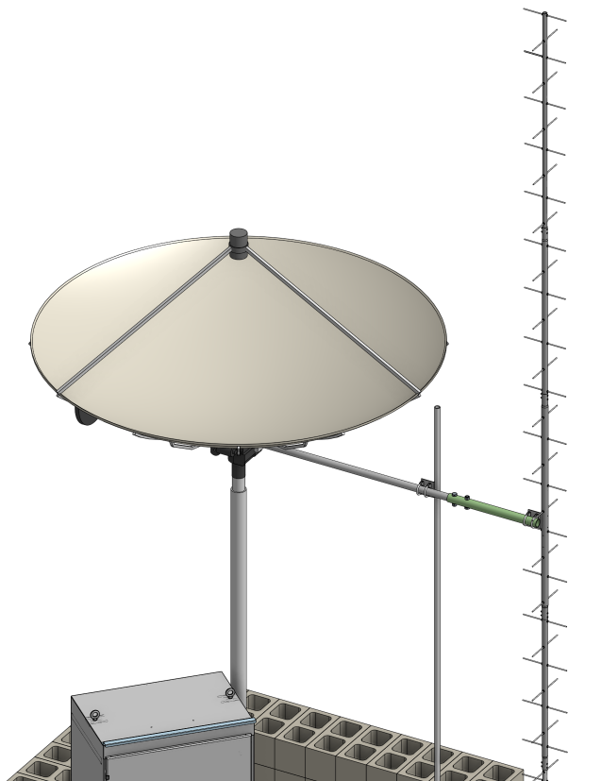
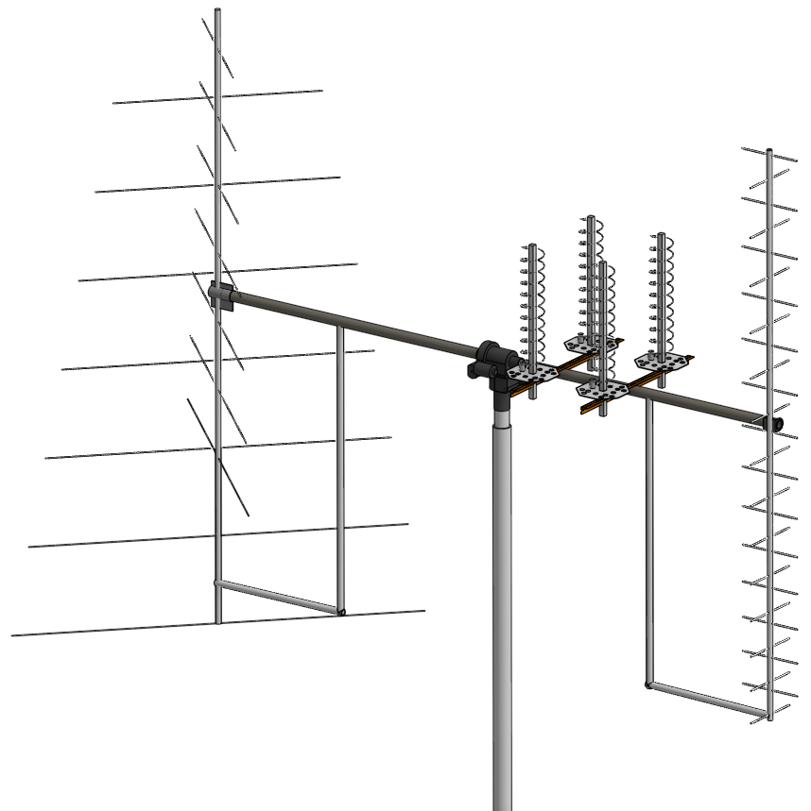
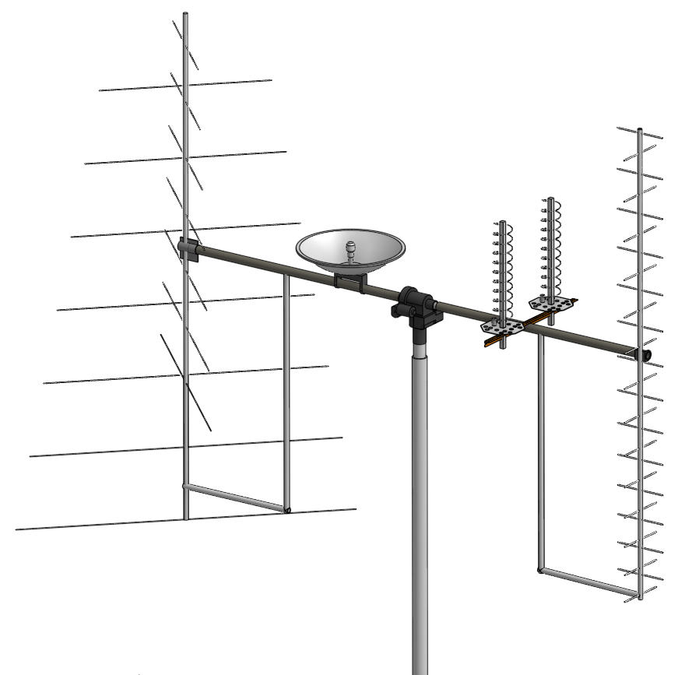
Choose your Antennas
VHF + UHF + L
VHF + UHF + L + S
UHF + L + S
Notes:
Choose from a bunch of different antennas and bands, including Yagis and dishes and helicals

Slide 28
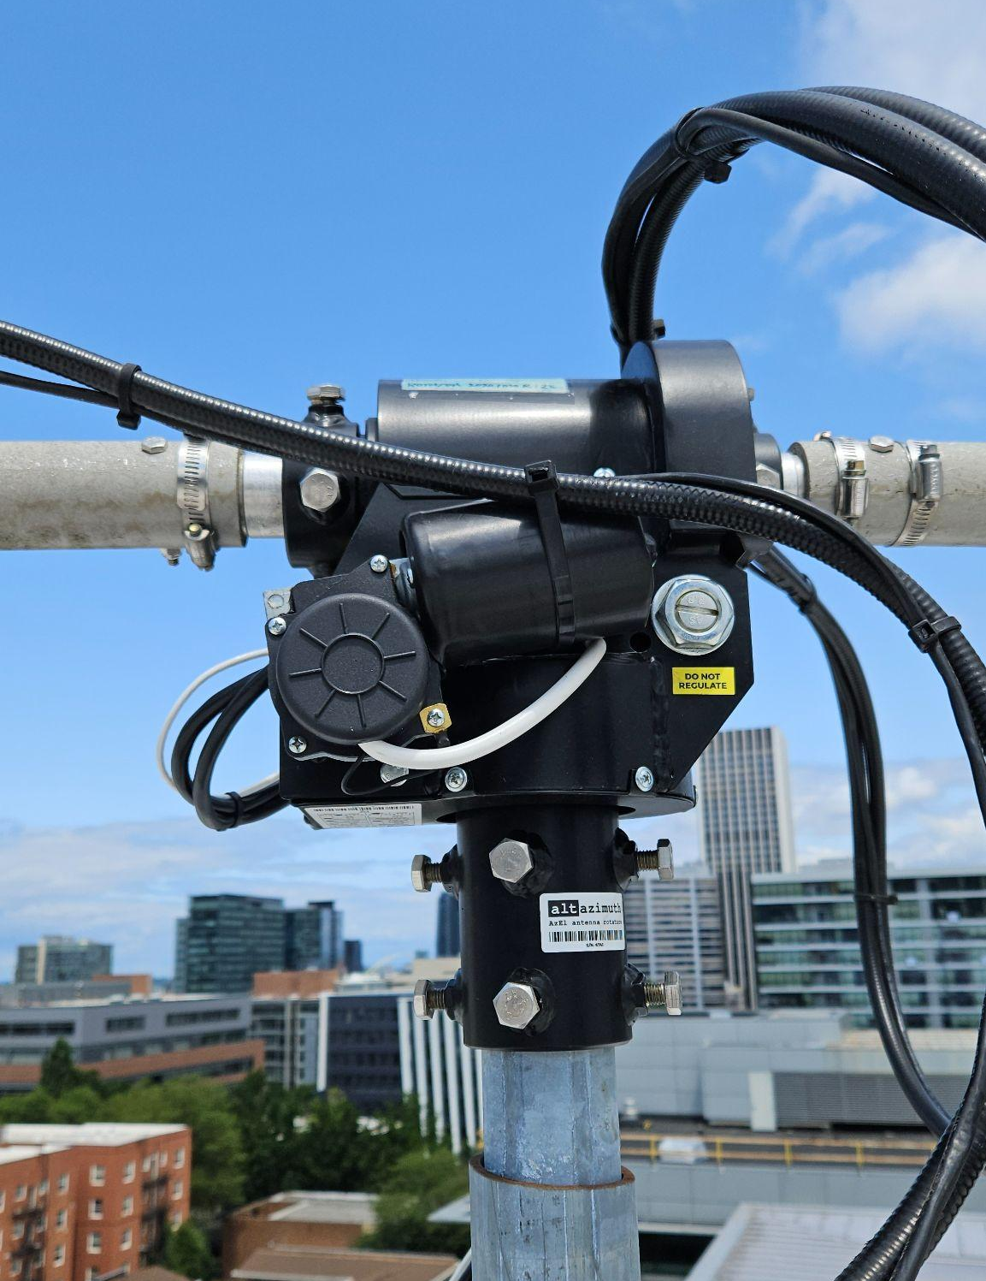
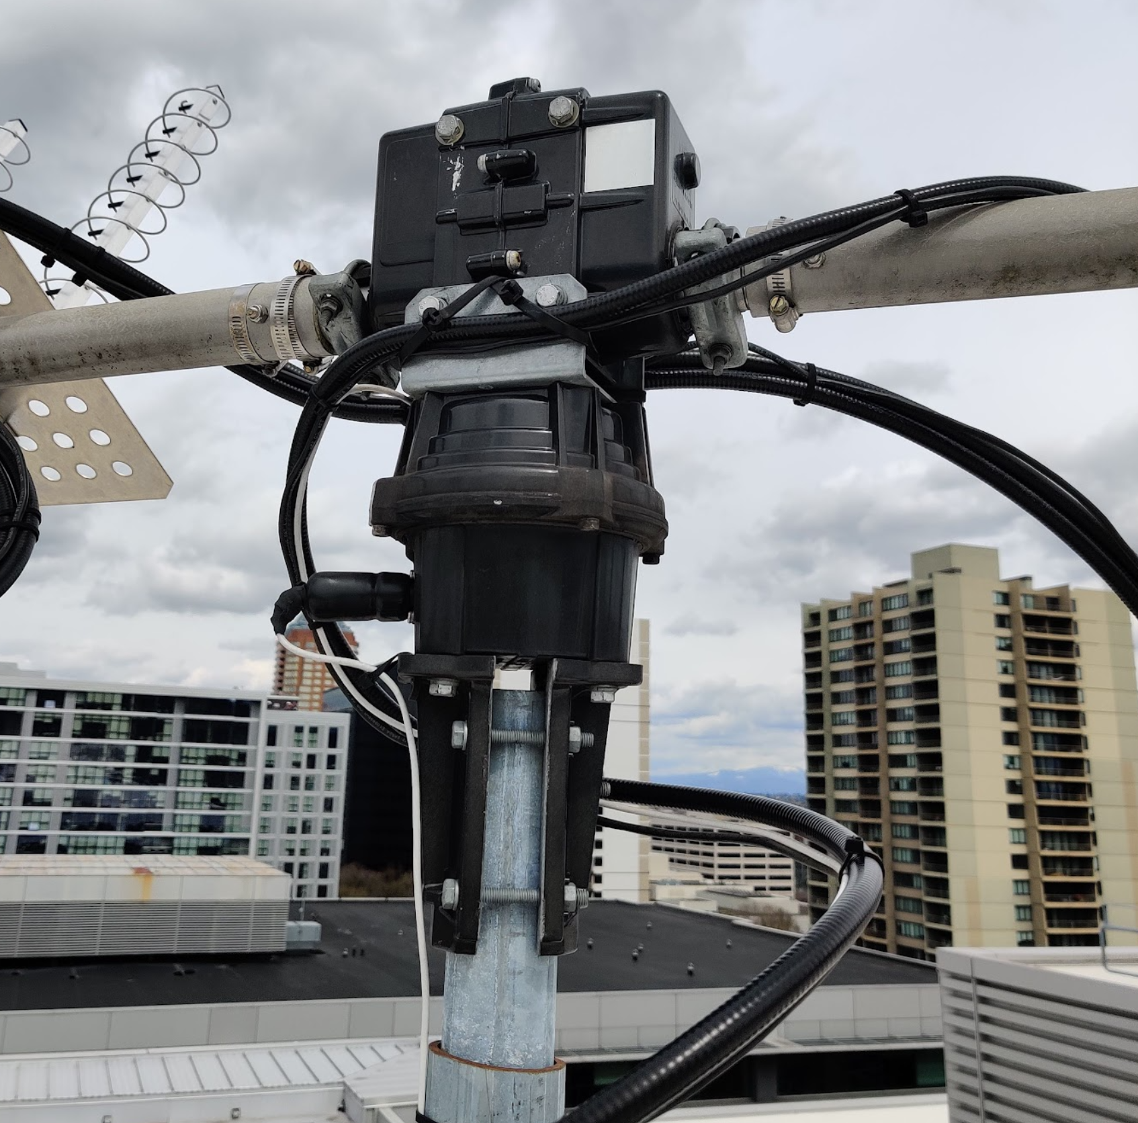
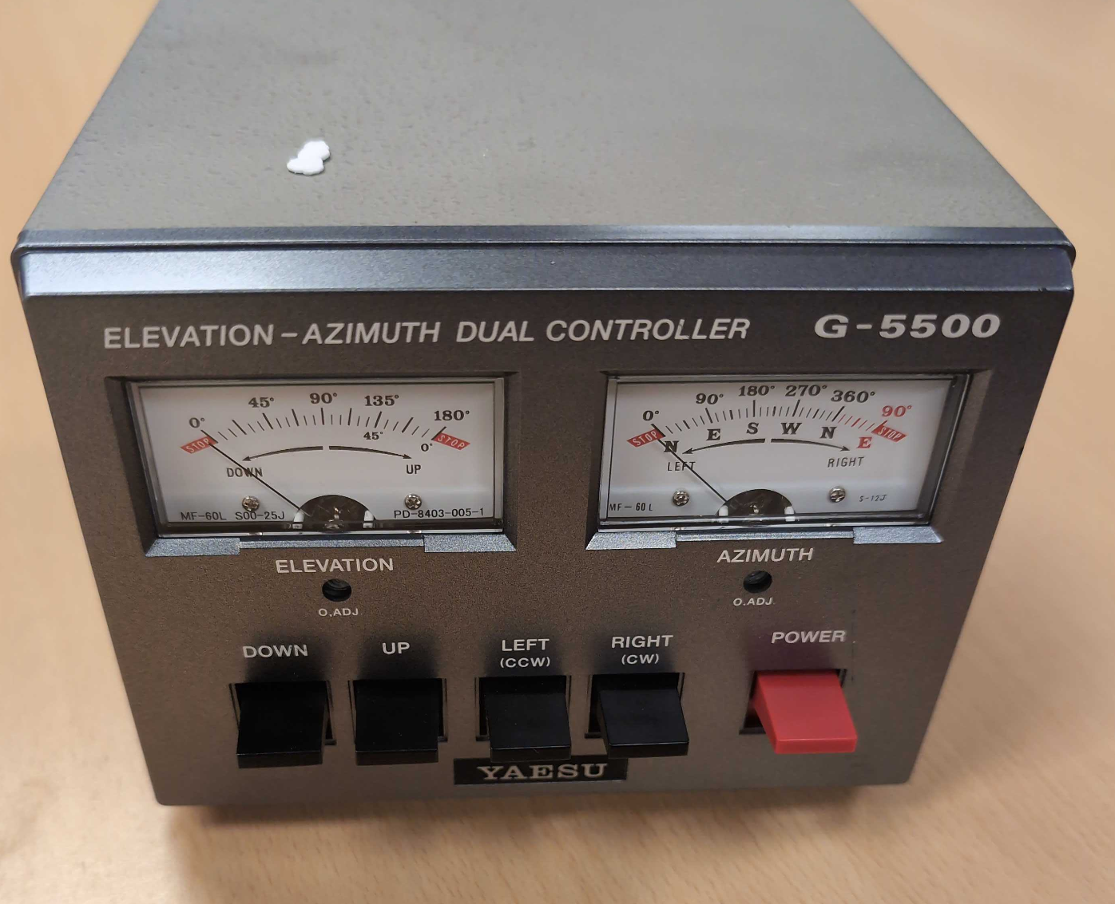
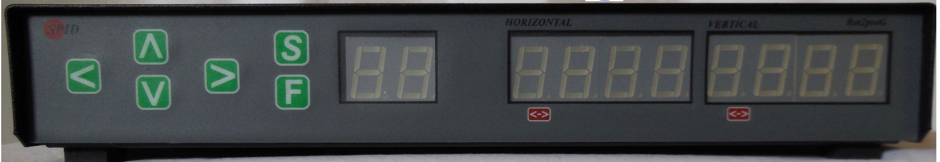
Choose a Rotator + Controller
Alfa RAS / ROT2
Yaesu G5500 & K3NG Interface
Notes:
We’ve identified two AZ/EL rotators, and we’ve used both. Rotator pointing accuracy (and thus cost) is driven by the antenna requirements.

Slide 29
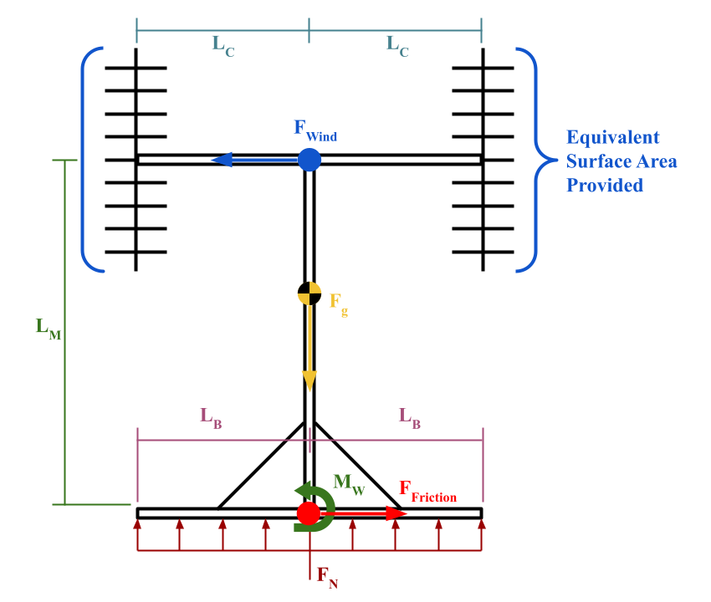
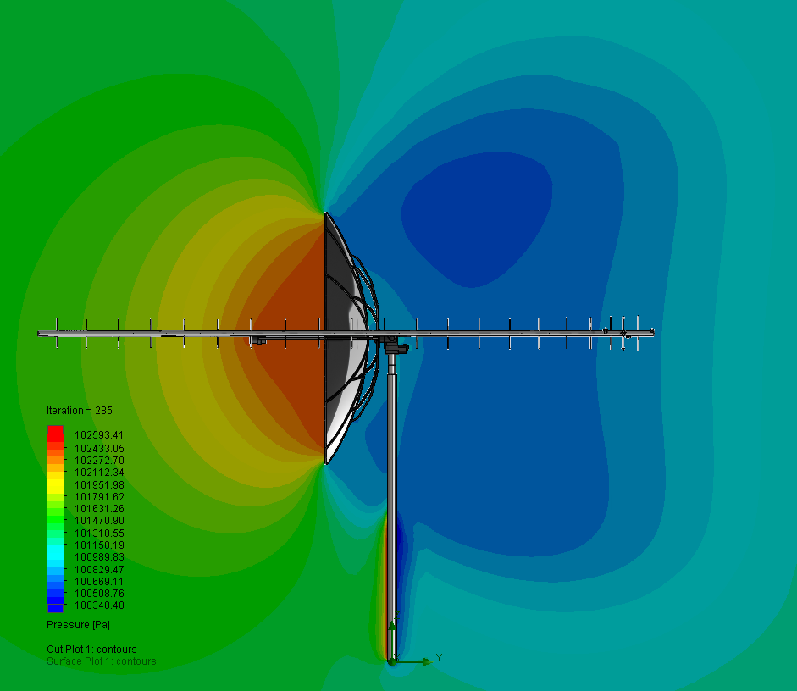
With some dynamics and CFD…
Notes:
We did some force dynamics, and some computational fluid dynamics to figure out the forces on the mast and mount.

Slide 30
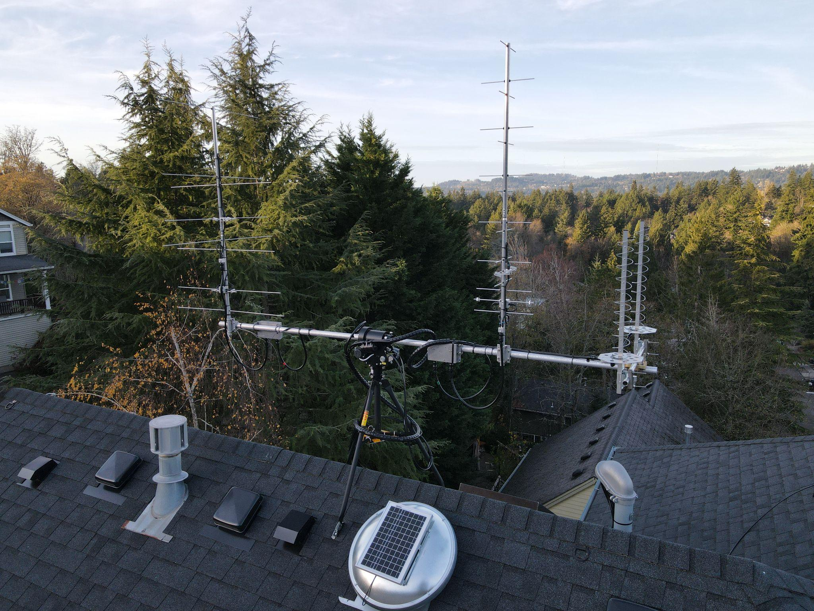
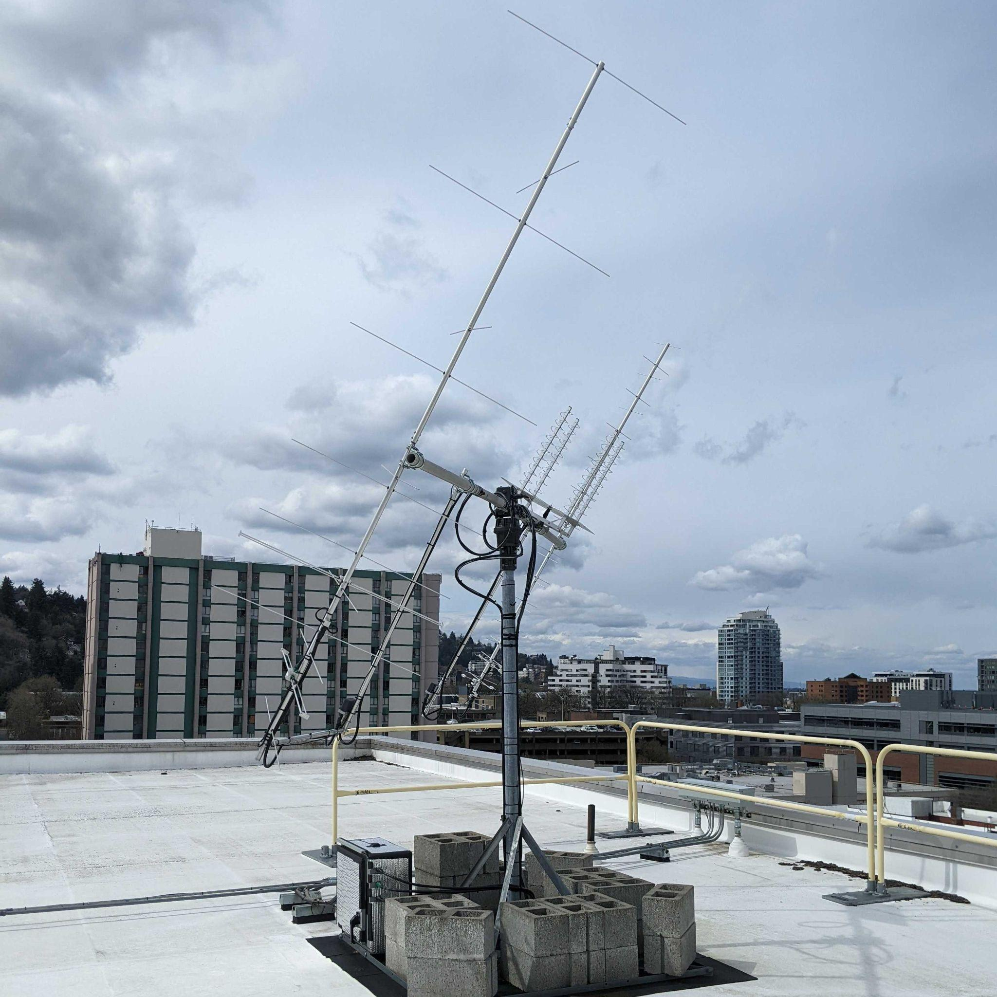
… choose a Location & Mounting type
Notes:
Left: Nonpenetrating roof mount with concrete block ballast, right roof tripod

Slide 31
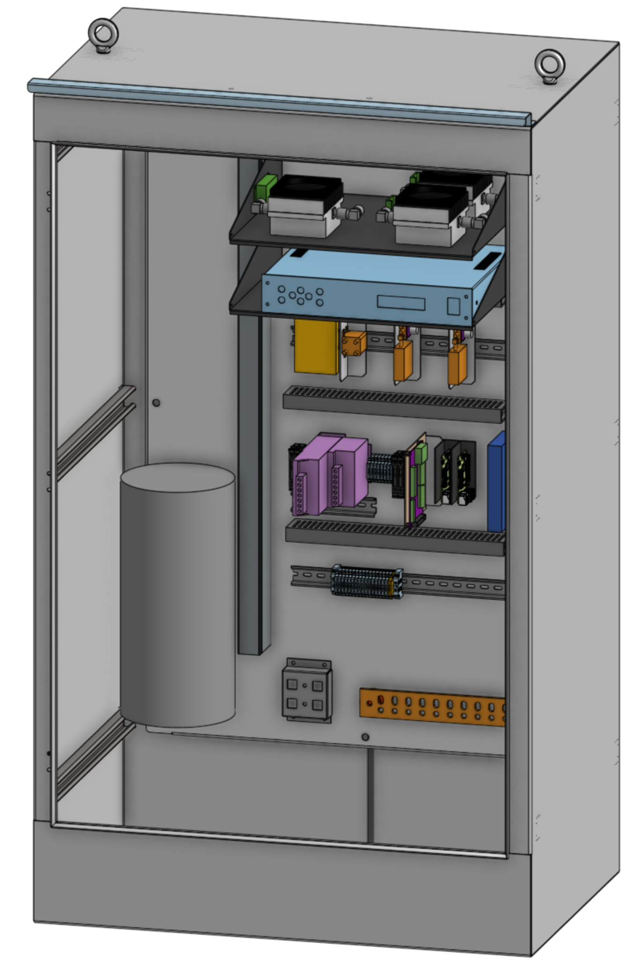
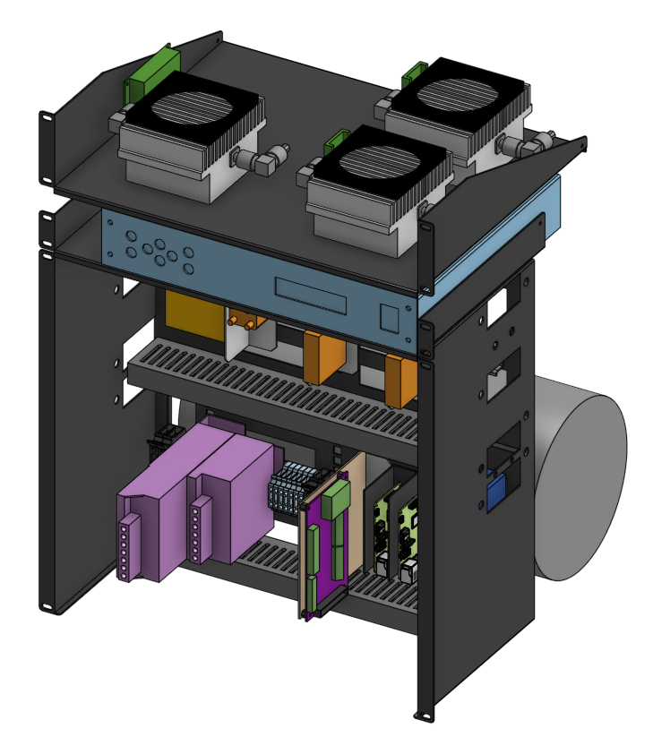
Choose your Electronics Location
Indoor 19” Rack System
Outdoor Enclosure with DIN rails
Notes:
You can put your electronics indoor in a rack, our outdoors in an enclosure.

Slide 32
Example Stations

Slide 33
PSU UniClOGS v1
Location: Portland State University Engineering Building roof
Mount: Nonpenetrating mount with concrete block ballast
Mast: 10 ft
Rotator: Alfa RAS + ROT2
Antennas
  VHF: 14 element crossed Yagi (12.3 dBi)
  UHF: 30 element crossed Yagi (15.5 dBi)
  L band: Quad 10-turn RHCP helical (14.7 dBi)
Electronics enclosure: Outside-rated enclosure on mount
Notes:
Half power beam width, gain, -> pointing accuracy

Slide 35
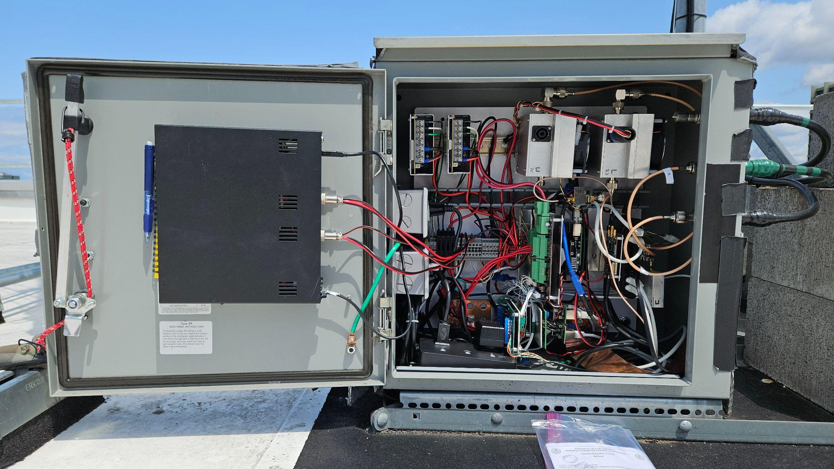

Slide 36
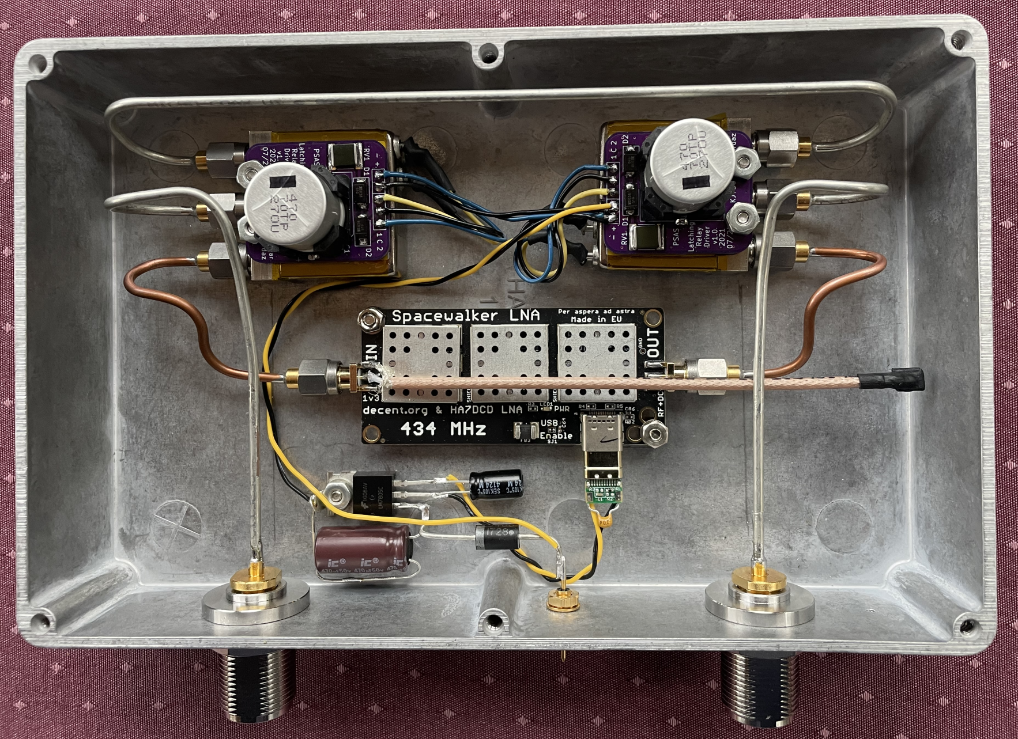

Slide 37
PSU UniClOGS v2
Location: Vernier Science Center at Portland State University
Mount: Nonpenetrating mount with concrete block ballast
Mast: 10 ft
Rotator: Alfa RAS + ROT2
Antennas
  VHF: 14 element crossed Yagi (12.3 dBi)
  UHF: 30 element crossed Yagi (15.5 dBi)
  L band: Quad 10-turn RHCP helical (14.7 dBi)
Electronics enclosure: Outside-rated enclosure on mount

Slide 38
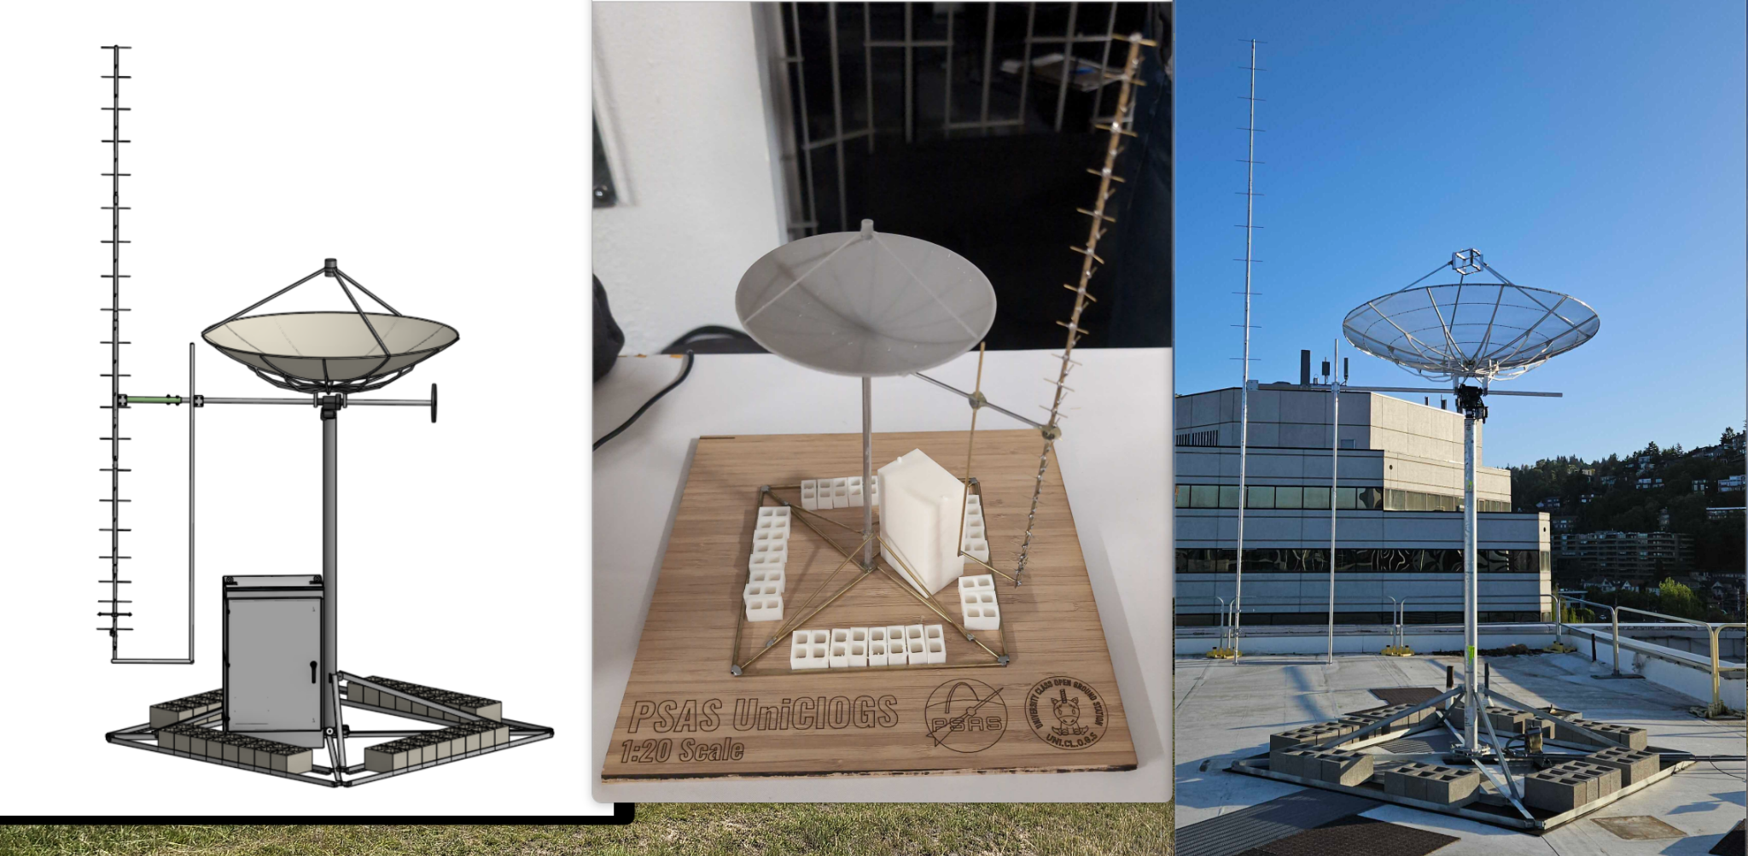

Slide 39
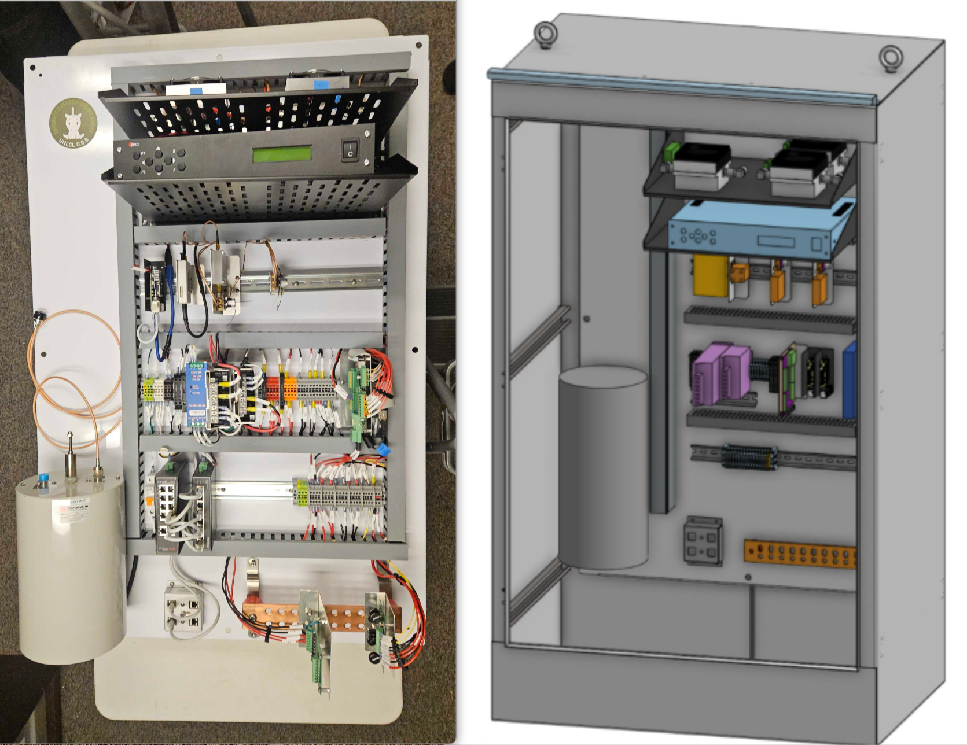

Slide 40
UCL UniClOGS (in progress)
Location: University College London Mullard Space Science Lab Holmbury House
Mount: Poured concrete
Mast: 10 ft
Rotator: Alfa RAS + ROT2
Antennas
  VHF: 14 element crossed Yagi (12.3 dBi)
  UHF: 30 element crossed Yagi (15.5 dBi)
  Future: Small S band dish
Electronics enclosure: inside 19” rack

Slide 41
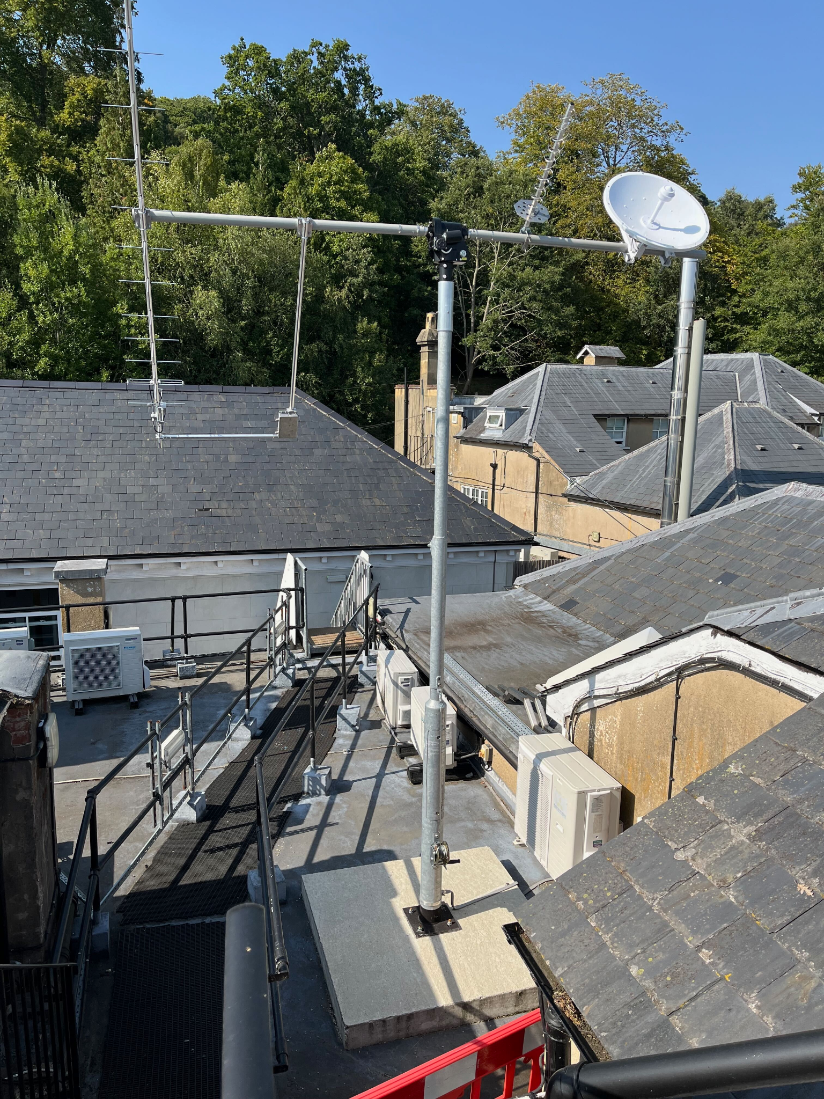
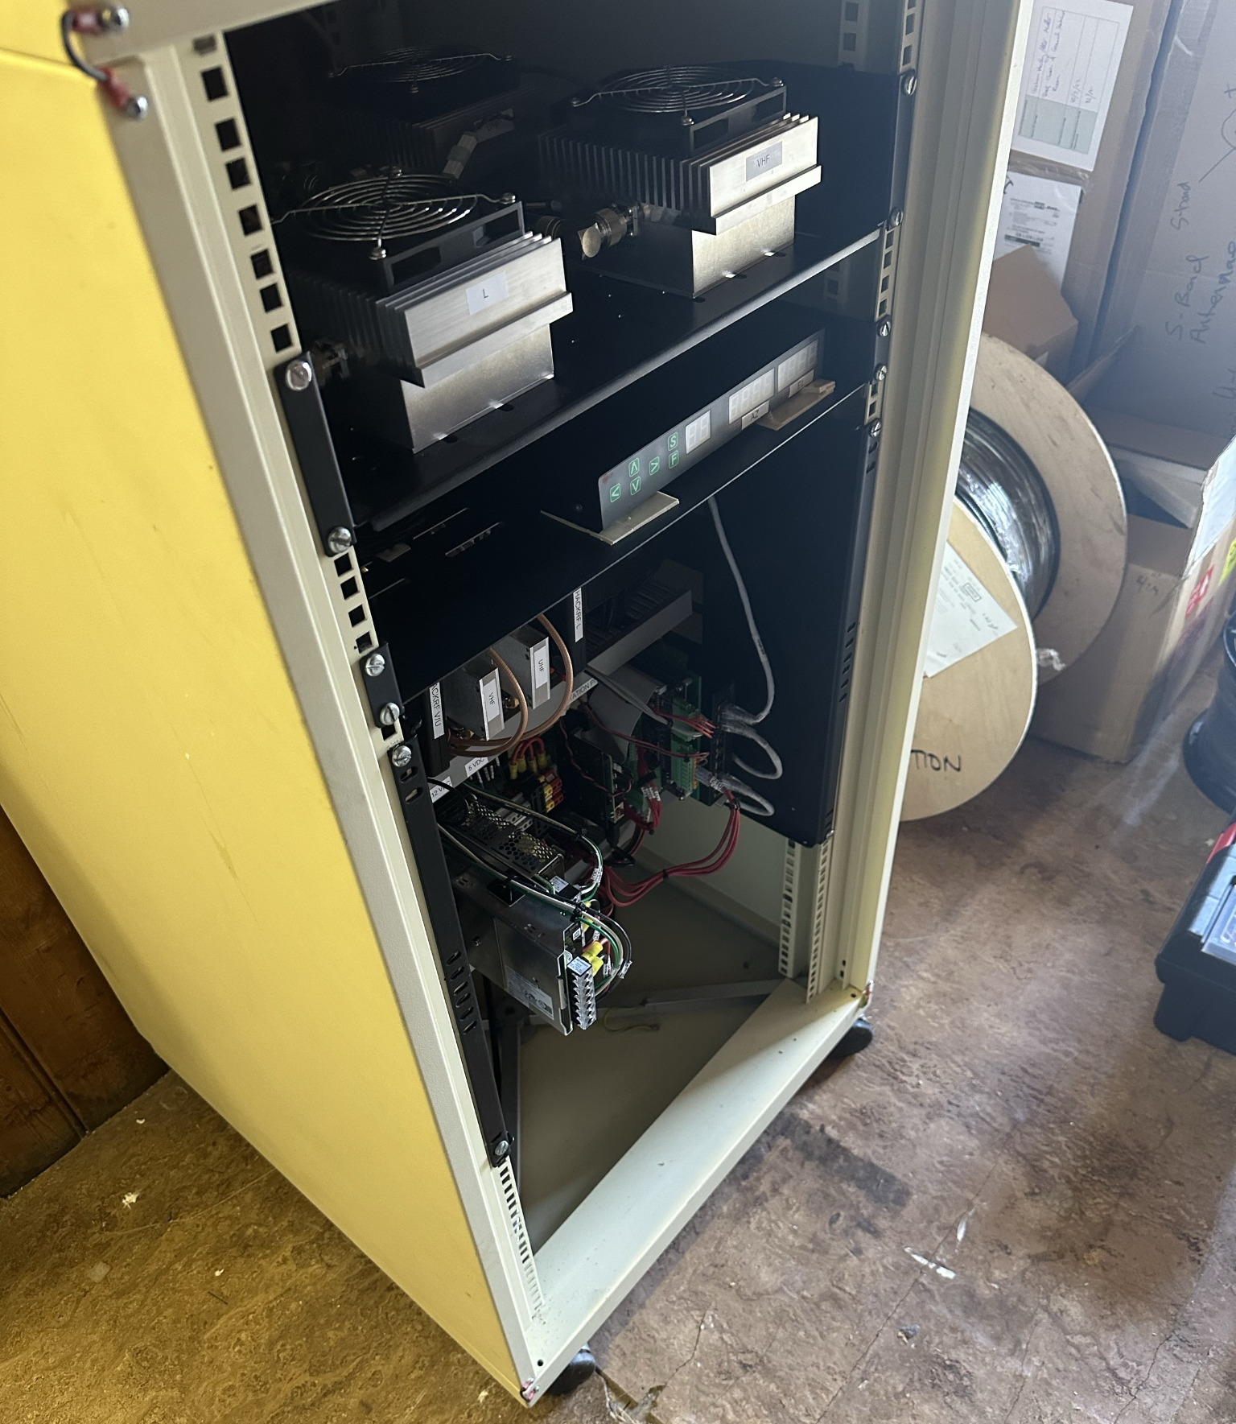

Slide 42
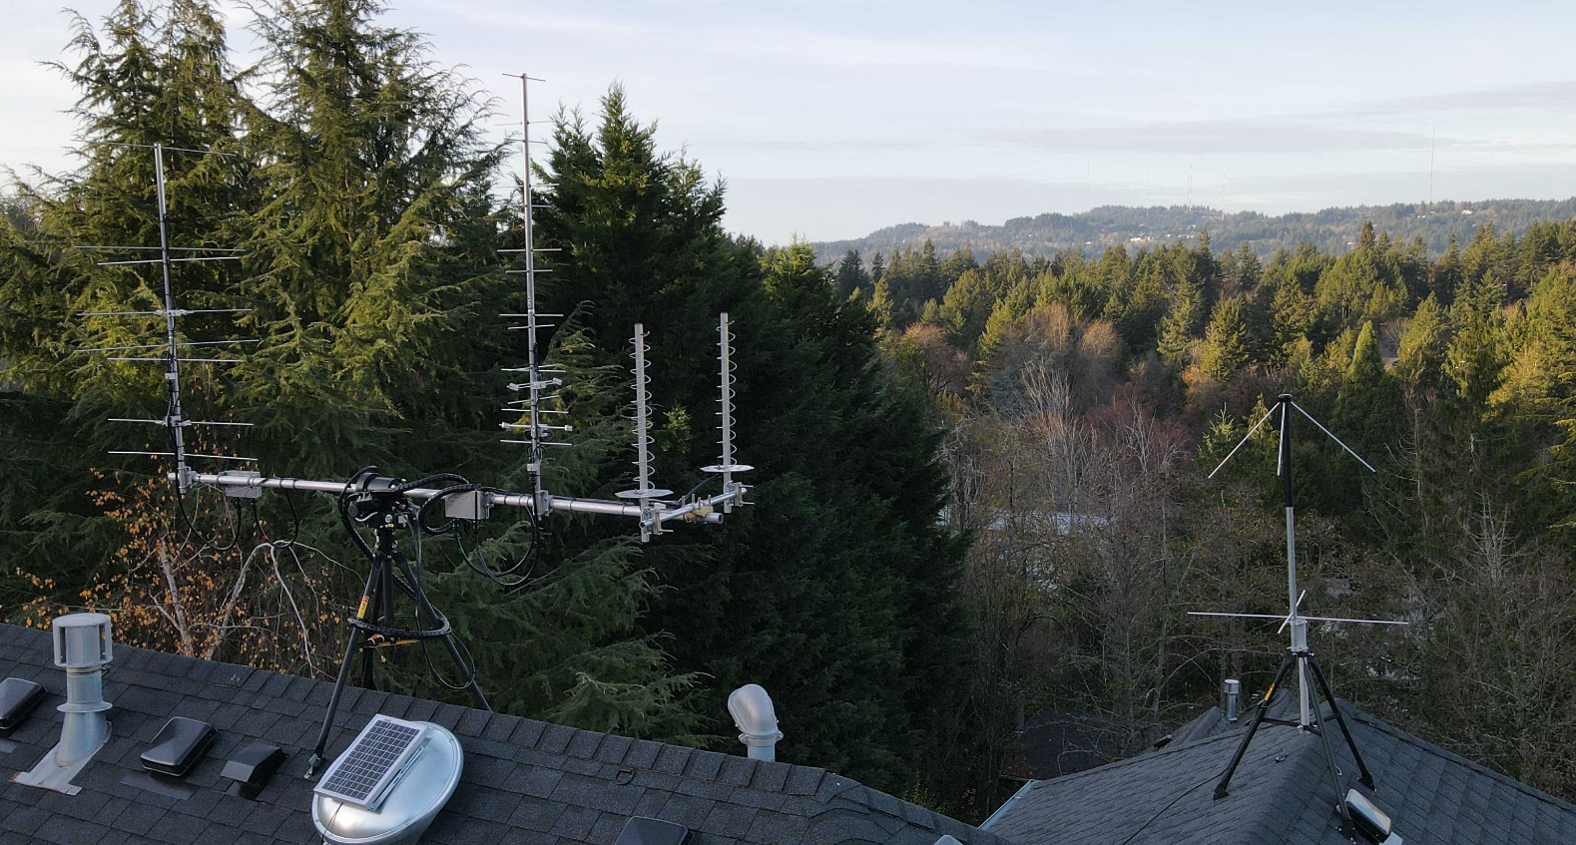
KJ7SU Station

Slide 43
The Inside Guts

Slide 44
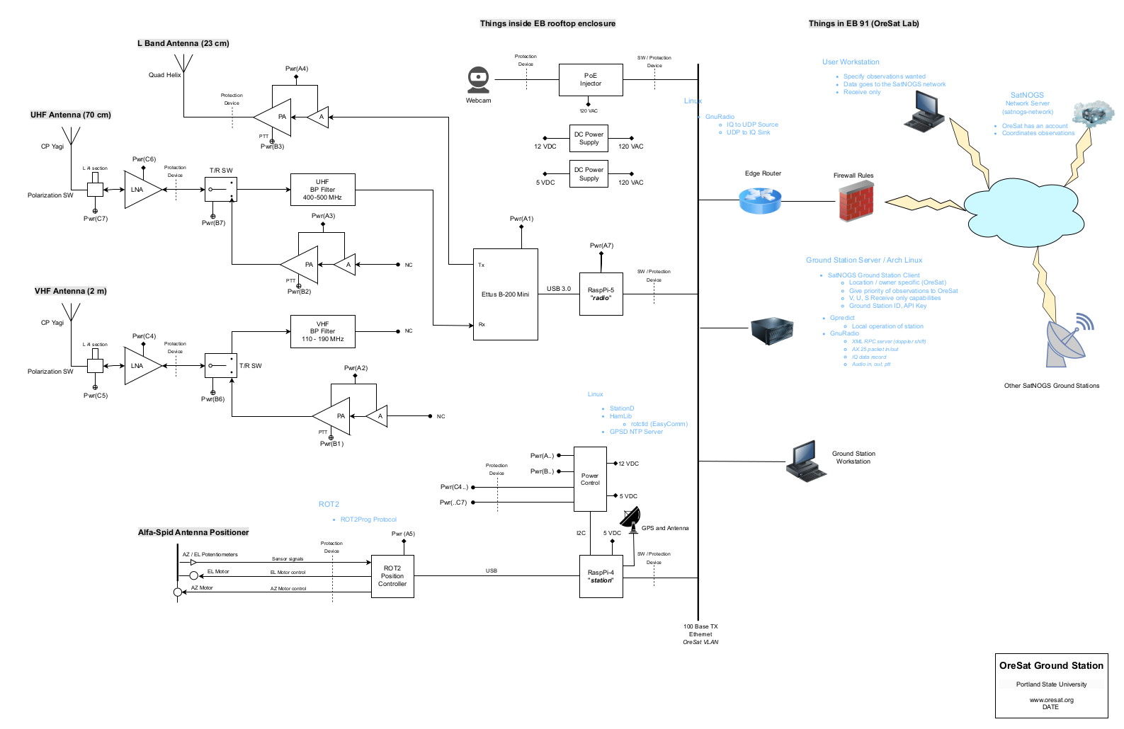
System Block Diagram

Slide 45
Radio Host + SDR + LNAs + PAs
Notes:
All of our RF components are COTS, including the PAs, LNAs, and our SDR. SDR is currently Ettus B-200 mini. SDR computer is Raspberry Pi 5, which finally has enough computing power to run SDRs.

Slide 46
Station Host + Power Control
Notes:
We use any Raspberry Pi to run power and rotator control

Slide 47
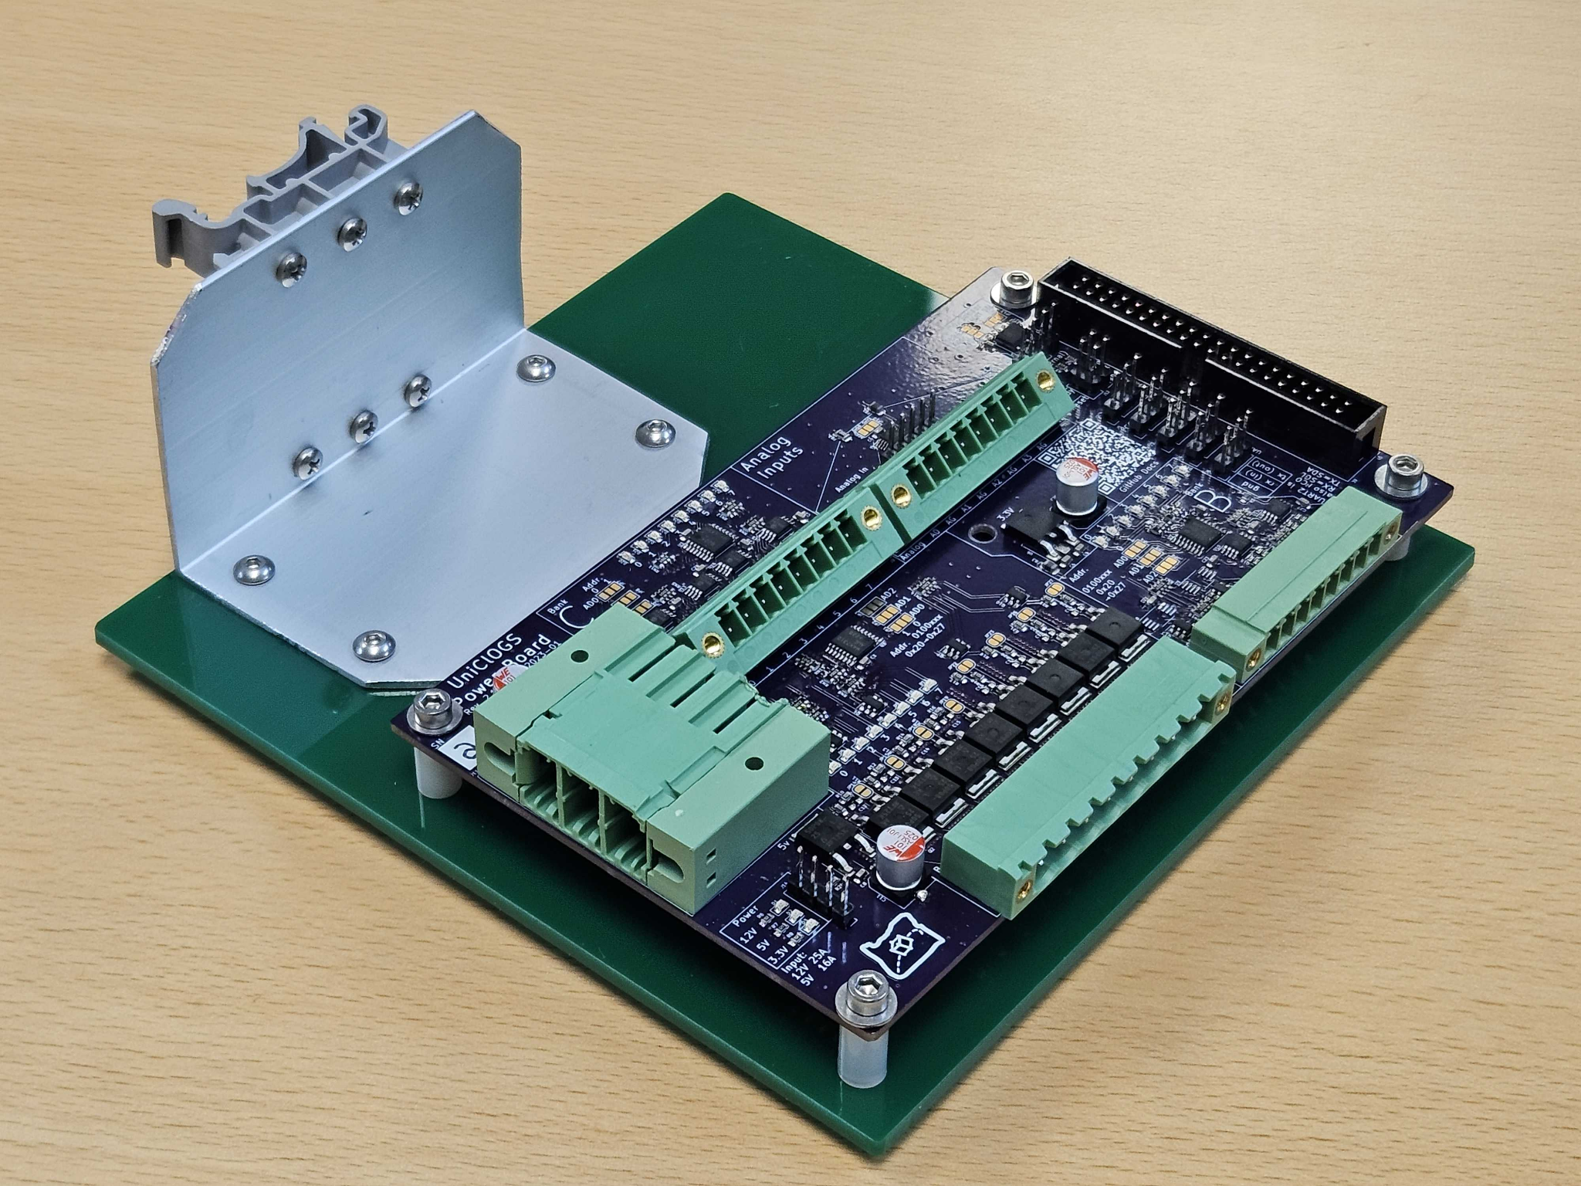
UniCloGS Power Control
Notes:
Switch many kinds of loads - 12V, 5V, etc - easily from the Station host (the Raspberry Pi 4).

Slide 48
Don’t forget the “Glue”!
½ inch Superflex Heliax™ coaxial cable
Protection devices (Lightning)
Band-pass filters
Coax switching (as necessary)
So. Many. Zip ties.
  Outdoor rated, of course
Notes:
These things are CRITICAL but we won’t talk about them lol

Slide 49
External Services
Power
  120 VAC 15 A (more than enough)
  Could be solar powered (but more expensive)
Network
  ≥ 100 Mbps Ethernet connection
  5 port switch
  Could be WiFi (but not as reliable)
Notes:
If you have more time: talk about the cost and delay of university facilities

Slide 50
Software

Slide 51

Software Block Diagram
Notes:
We use GnuRadio running on the Raspberry Pi 5 to talk to our SDRs. Yamcs (“Yet Another Mission Control Software”) controls the communications to the satellite. Lots of Python glue programs to pull everything together.

Slide 52

Example: Operating 2 stations
UniClOGS EB v1 Station
UniClOGS KJ7SU Station
Notes:
Software/operators view sees the same no matter the configuration

Slide 53


“FlatSat” & “FlatClOGS” Integration Platform
Hardware-in-the-loop Testing
Simulation Objectives:
Signal loss based on distance: acquisition of signal, packet drops, loss of signal.
Background noise in the signal
Digitally controlled attenuators
RF Link Simulation Station (above), system diagram (below)
Notes:
Going to pull slides from here:
https://docs.google.com/presentation/d/1ky3DYPjDoZ6CpSG24_9EfDH1Dr0ta5p08JRHfvCd35o/edit?slide=id.p#slide=id.p
Two way radio with interference injected

Slide 54
Documentation!

Slide 55

Instructions Included
Location considerations
Protection and filtering considerations
Example BOMs
Assembly guide
Installation guide
Testing guide
Software install
Future
  Operations

Slide 56
















A TON of documentation!

Slide 57
A TON of documentation!

Slide 58
A TON of documentation!

Slide 59


Learn More And Get In Touch
HUGE Thank you to:
Amateur Radio Digital Corporation
Oregon Space Grant Consortium
IEEE Oregon Section
Find out more, including access to this
slide deck, at https://www.uniclogs.org/
Check out our paper!
“University Class Open Ground Station (UniClOGS)”
Notes:
Thank you, and please reach out!
https://digitalcommons.usu.edu/smallsat/2024/all2024/23/
GRAB BUSINESS CARDS!!

Slide 60

Radio Amateurs and Radio Astronomers Club at Portland State University
We started a radio telescope project with Rose City Astronomers!
We will plan stuff in the future!
ANY HELP WILL BE APPRECIATED!
Pacific Time
Notes:
Dennis Rosenhaur (AC7FT) - https://events.gnuradio.org/event/26/contributions/760/attachments/219/585/grcon_sep_25.pdf

